Slide 1
Creating a Webpage
Using GW Blogs

Slide 2
Visit blogs.gwu.edu, click LOG IN

Slide 3
Sign in with NetID

Slide 4
Log in using your GWU NetID

Slide 5
Accept the terms/conditions and privacy info

Slide 6
Creating a new post – 1
In your dashboard on the left side, select Posts and then Add New

Slide 7
Creating a new post – 2
A) Give your post a title and provide any text you want.
B) Publish to save your changes, and then you can select Preview Changes to see what your site looks like.
A)
B)

Slide 8
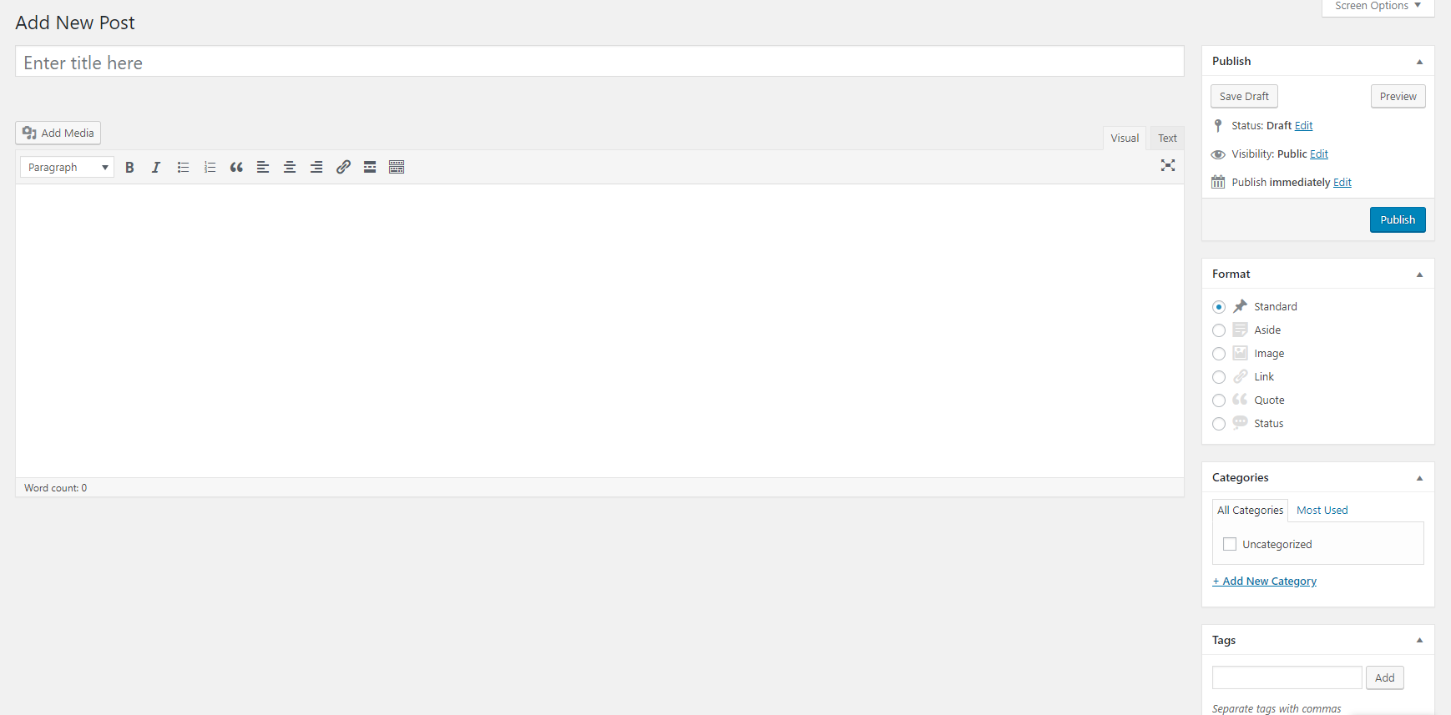
Adding media – images, video, word, or pdf. 1 - Click the Add Media button.

Slide 9
Adding media – 2 – select Upload Files

Slide 10
Drag files into box or click “Select Files”
Clicking “Select Files” will open a browser allowing you to select the files you want to upload. Once you have uploaded a file, click Insert Into Post at the bottom right.
Insert Into Post creates a link to your file that can be used by visitors.
Once files have been uploaded, they can be found again in the Media Library tab shown in this window.

Slide 11
Linking to Another Page
Highlight the text that you wish to turn into a link. Click the button indicated below, and paste the desired URL into the window that appears.

Slide 12
Changing Site Visibility
In the dashboard on the left side, select Settings -> Reading
Look for “Site Visibility”, and select your preferred option. “Discourage search engines from indexing this site” is recommended if you want anyone to be able to access your page. Otherwise, consider setting a password or selecting “Visitors must have a login - anyone that is a registered user of GW Blogs can gain access.”

Slide 13
To Do During Lab
Create a page called resume and link resume to your main page
If you already have a resume, you can upload it using the “Adding Media” approach shown earlier
Create a power point presentation describing your ECE, MAE, EMSE, etc. project
Create a link from your main page to your presentation file
Add your Matlab results in the form of a word document from the SEAS matlab project from previous weeks.
Example Class Schedule (Does not have to use real courses/times)
Personal (Major/Interests/Photo); can be deleted after the presentation.
Major and Its Description
Links to:
Department web site, Student Activity Groups, Professional Associations, Hobbies/Interests
Customize your site (Professional Look)
Include all the above information on your web page
Be prepared to present your web site, and power point presentation on Dec. 6th
NOTE: All presentations MUST be done from the web page. Large videos may be an exception. (We recommend uploading videos to YouTube for easy access)
NOTE: This is the suggested assignment for your work during the lab. However, please refer to the project presentation and report guidelines for the detailed list of required content for your webpage.

