Slide 1

Command Line Tutorial
Based on a presentation by Ryan Fisk

Slide 2
Step 0: Set up
If you have a Mac or use Linux (ask a TA/LA if you’re unsure) you can IGNORE THIS SLIDE
For WINDOWS USERS ONLY
  Open the windows search bar
  Type “cmd”
  Right click on Command Prompt and select “run as administrator”
  Type in “wsl --install” (all lower case, two dashes in front of install) and press enter
  This will let you use Linux commands on Windows
    If you don’t know what this means, don’t worry about it (not something we talk about in this class), but you can come back and thank us later ;)

Slide 3
First, some definitions
File: a representation of data (text, code, or applications) for your operating system
  Naming consists of filename.extension
    Filename is just an identifier (i.e., Homework_4)
    The extension tells you what type of file it is (*.docx, *.ppt, *.java, etc)
Directory: a collection of files (like a folder)
  For our purposes, a directory is no different than a folder on your desktop
  However, your desktop itself is also a directory
  Tells us WHERE a file is stored

Slide 4
Part 1: Navigating Directories

Slide 5

The “GPS” of the command line: PWD
Let’s start with the obvious, how do I even know where I am in the world of files/directories?
In the real world, a GPS tells me where I am
In the command line, we use “pwd” as our GPS
* /Users/<your username here> is also referred to as the Home directory, every time you open a new terminal, you start here

Slide 6

Moving through directories: CD
Now that we know where we are, we can start to navigate around a bit
Recall that for our sake, Directories are roughly the same as folders
We can change folders (or change directories ;) ;)) using the “cd” command
  We do this by typing “cd” and then the name of the directory we want to go into
Let’s use cd to get to our desktop:

Slide 7
The most common commands (ever) Pt 1: LS
We learned how to orient ourselves and move to a new directory, but how do I see what else is there (and create new things?)
We can list all files/directories are within the directory we’re currently in with “ls”
As you can imagine, seeing what files are in a folder is a very useful tool

Slide 8
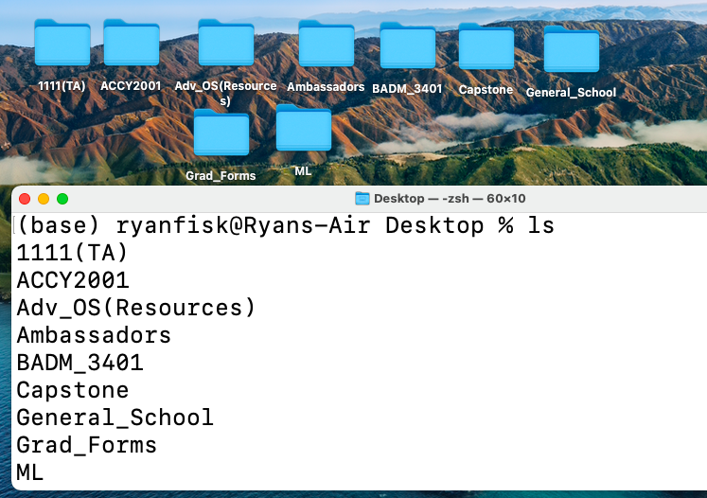
*Notice how everything in the output of ls is a folder on my desktop

Slide 9
The most common commands ever Pt 2: MKDIR
What if I want to make a new folder?
Alternatively, what if I wanted to make a directory ;) ;)
The “mkdir” command lets me make a new directory

Slide 10
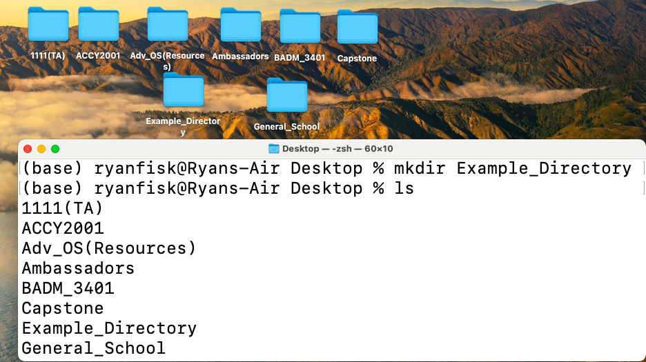
*Notice it makes the folder on my desktop (which is where we cd-ed into

Slide 11


First Exercise
Please do the following:
Let one of the TAs/LAs know if you get stuck/when you finish
Navigate to the folder you use for this class in the command line (if you don’t have one already, make one)
Print out all of the files you have in that folder
Make a new directory called “lab_examples”
Cd into it and print the “GPS” location of it

Slide 12
Part 2: Interacting with Files

Slide 13

Review
All of you right now -->
Congratulations! You just became first-time hackers ☺
  Just being able to navigate around the file system and see what’s there is one of the most important skills you can learn
Now that we can move around, let’s see how we interact with what we find

Slide 14
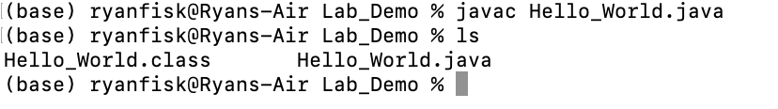
Compiling and Running
Now that we’ve created a new java file, we can compile and run it
To compile, use the command “javac filename.java”
Hello_World.class is the executable/class file

Slide 15

Compiling and Running
Once we have Hello_World.class, we can run the code
We use the command “java filename” to run a java executable
  Notice there is NO extension after the filename
  In this case, it would be “java Hello_World”

Slide 16
Second Exercise
Please do the following:
Let one of the TAs/LAs know if you get stuck/when you finish
Use VSCode to create and save the HelloWorld.java file from class in a directory of your choice
In the terminal, navigate to that directory
Show the contents of that directory using ls, verifying your HelloWorld.java file is there
Compile and run your HelloWorld.java file from the terminal

Slide 17
Meta: Everything is a File
Recall the output of the pwd command
  Something like /users/ryanfisk/desktop/…
  Have you seen that “/” separation anywhere else?
    www.google.com”/”images
    https://www2.seas.gwu.edu’/’~kinga’/’CS1111’/’homeworks’/’Homework5.java
Every application, website, video game, movie, YouTube video, TikTok, etc. is represented as a file or collection of files
  Don’t worry too much about this, you’ll learn why and how later
  The benefit is we don’t need different ways to interact with each one

Slide 18
Part 3: Downloading external libraries

Slide 19
Doing cool things with Java
We learned how to compile and run a simple Java program in the terminal
Running programs from the terminal allows us to do a virtually infinite set of complicated tasks, use code other people have written, and combine tools
Next, we’re going to download a style checker (which we’ll learn about later this semester) to use to check the style of the Java programs we write

Slide 20
Third Exercise
Please do the following:
Let one of the TAs/LAs know if you get stuck/when you finish
Download and save the three links below to the directory on your computer that has HelloWorld.java: https://github.com/checkstyle/checkstyle/releases/download/checkstyle-9.2.1/checkstyle-9.2.1-all.jar
and
https://www2.seas.gwu.edu/~kinga/CS1111_S22/labs/checkstyle.html
and
https://www2.seas.gwu.edu/~kinga/CS1111_S22/HelloWorld.java
In the terminal, navigate to that directory.
Run the command at the right, and fix the style error, then rerun the command to check
Follow the link to right mouse click and save the file as instructed
Copy and paste the file into your text editor, and save it as HelloWorld.java
java -jar checkstyle-9.2.1-all.jar -c ./CS1111_checks.xml HelloWorld.java

