Slide 1
ECE 3130 – Digital Electronics and Design
Lab 8
Shift Register
Fall 2012

Slide 2
Introduction
A shift register is a cascade of flip-flops that allows the bit-wise movement of the data contained within it
Today we will…
Design a bidirectional, parallel-load shift register using DFFs
Implement a clear control to clear the register to 0

Slide 3
Function table for the register
Mode control |  | Register Operation
S1 | S0
0 | 0 | No change
0 | 1 | Shift Right
1 | 0 | Shift Left
1 | 1 | Parallel Load

Slide 4
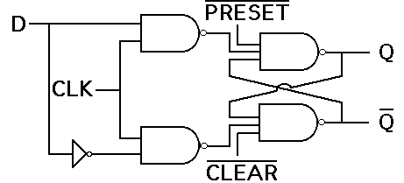
DFF with CLEAR

Slide 5
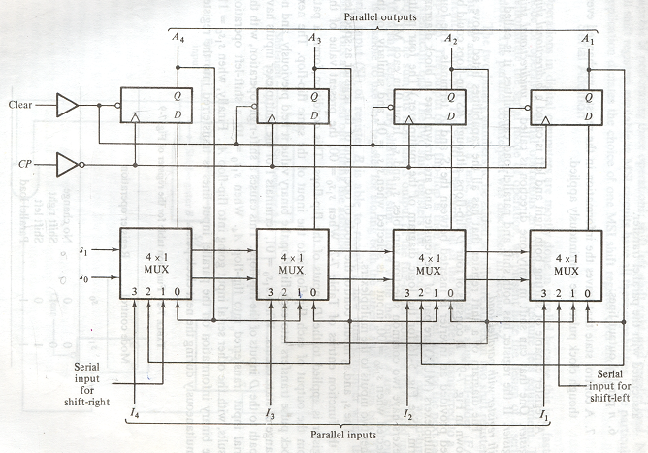
Schematic Design

Slide 6
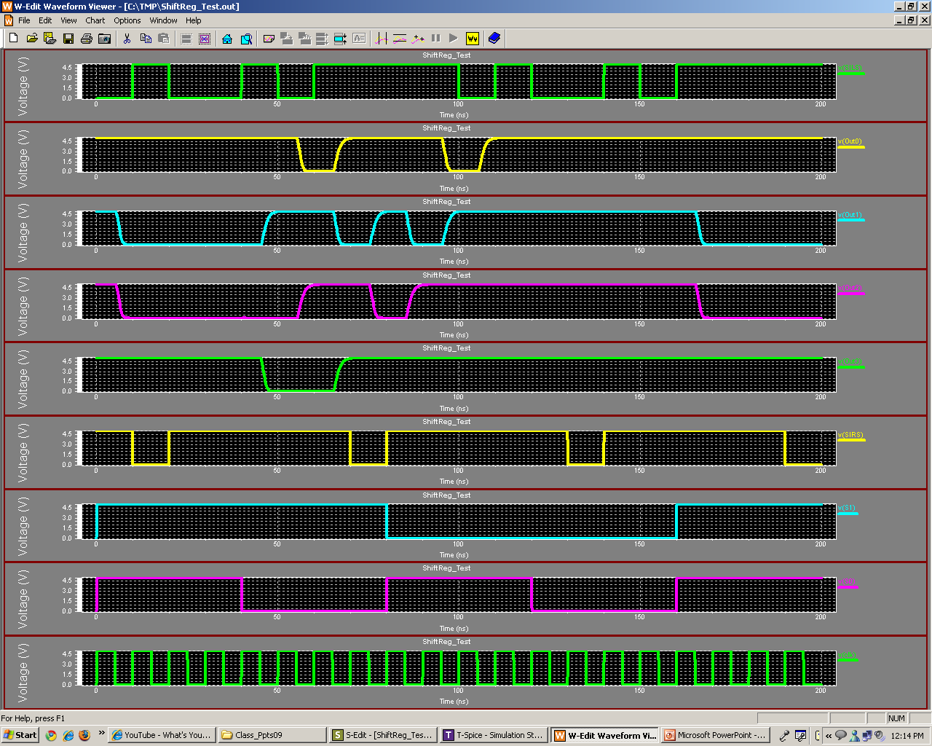
Output response
Serial input left shift
Out0
Out1
Out2
Out3
Serial input right shift
S1
S0
Clock

Slide 7
Analysis
What are some applications of shift registers?

