Slide 1
ECE 3130 – Digital Electronics and Design
Lab 7
Binary Counter
Fall 2012

Slide 2
Introduction
A binary counter is a device that stores the number of times that an event/process occurs
Up/down counter
When the selector is in the up state, the counter increments its value
When the selector is in the down state, the counter decrements its value

Slide 3
JK Flip-Flops
A universal flip-flop – can be configured as a SRFF, DFF, or TFF
Identical to an SR flip-flop except that S=R=1 is no longer undefined, but rather “toggle/flip”
J/S | K/R | Qnext
0 | 0 | Q (hold)
0 | 1 | 0
1 | 0 | 1
1 | 1 | nQ (toggle)

Slide 4
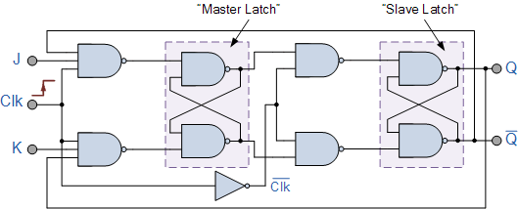
Master-Slave JKFF Implementation

Slide 5
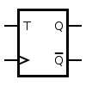
Up/down counter using T Flip-Flops
Circuit Symbol
Truth Table
T | Q | Qnext
0 | 0 | 0
0 | 1 | 1
1 | 0 | 1
1 | 1 | 0
Tie the J and K inputs of the JKFF to make a TFF.

Slide 6
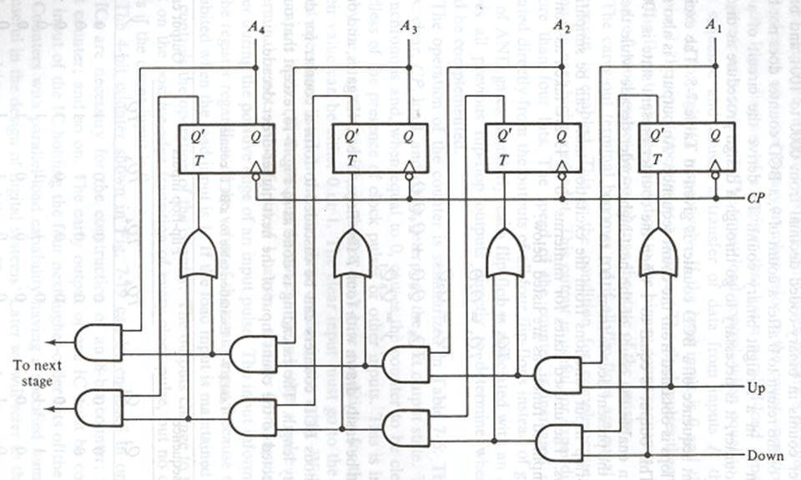
4-bit Up/Down Binary Counter

Slide 7
Analysis
What are some applications of counters?

