Slide 1
ECE 3130 – Digital Electronics and Design
Lab 6
State Machines
Fall 2012

Slide 2
What is a State Machine?
A model of a machine that can be in one of several states (e.g. traffic lights)
Different representations:
State tables
State diagrams
State equations

Slide 3
Mealy and Moore State Machines
Mealy machine
Output values are determined by both the current state and the current inputs
Moore machine
Output values are determined solely by the current state

Slide 4
Objectives
Design both a Mealy and Moore machine to detect the sequence, 1010, in a bit pattern
Draw a state table
Implement a Mealy machine using D flip-flops

Slide 5
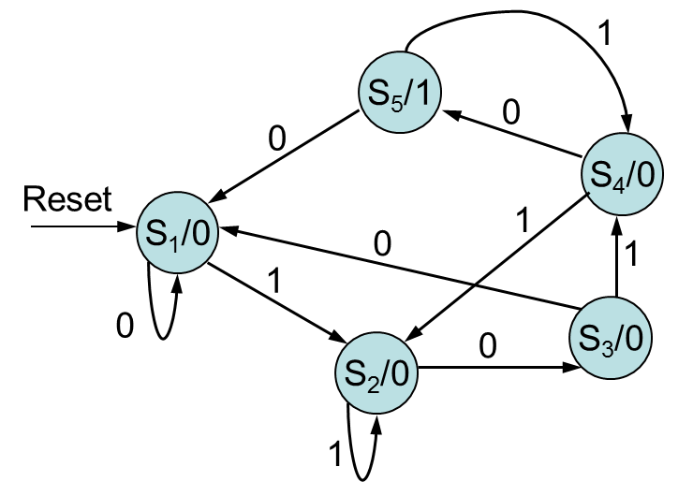
Moore Machine
Present State | Next State |  | Output
 | Input=0 | Input=1
S₁ (000) | S₁(000) | S₂(001) | 0
S₂ (001) | S₃(010) | S₂(001) | 0
S₃ (010) | S₁(000) | S₄(011) | 0
S₄ (011) | S₃(010) | S₂(001) | 0
S₅ (100) | S₁(000) | S₄(011) | 1

Slide 6
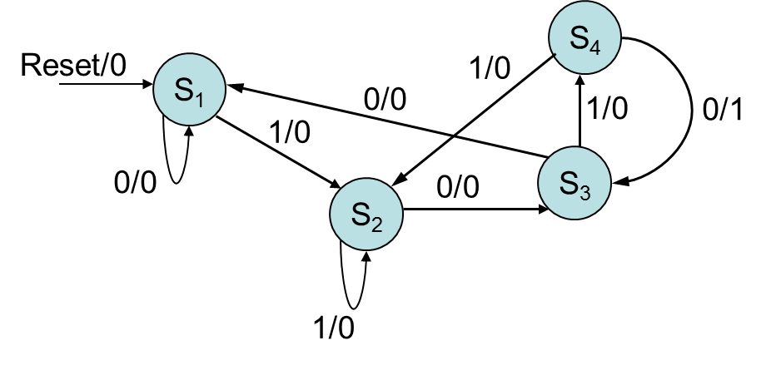
Mealy Machine
Current State | Next State |  | Output
 | Input=0 | Input=1 | Input=0 | Input=1
S₁ (00) | S₁ (00) | S₂(01) | 0 | 0
S₂ (01) | S₃ (10) | S₂ (01) | 0 | 0
S₃ (10) | S₁ (00) | S₄ (11) | 0 | 0
S₄ (11) | S₃ (10) | S₂ (01) | 1 | 0

Slide 7
Mealy Implementation using DFF
Inputs of combinational circuit |  |  |  |  | Output of combinational circuit
Present state |  | Input | Next state |  | Flip flop inputs |  | output
A | B | x | A | B | DA | DB | y
0 | 0 | 0 | 0 | 0 | 0 | 0 | 0
0 | 0 | 1 | 0 | 1 | 0 | 1 | 0
0 | 1 | 0 | 1 | 0 | 1 | 0 | 0
0 | 1 | 1 | 0 | 1 | 0 | 1 | 0
1 | 0 | 0 | 0 | 0 | 0 | 0 | 0
1 | 0 | 1 | 1 | 1 | 1 | 1 | 0
1 | 1 | 0 | 1 | 0 | 1 | 0 | 1
1 | 1 | 1 | 0 | 1 | 0 | 1 | 0

Slide 8
Circuit Implementation

Slide 9
Output

