Slide 1
ECE 3130 – Digital Electronics and Design
Lab 3
Multiplexers, Parity Generators, and Boolean functions using MUX
Fall 2012

Slide 2
Objectives
Last week…
You built a 2:1 MUX
For HW, you built a 4:1 MUX
Today…
Apply a 4:1 MUX to implement a parity generator and adder
Appreciate the useful applications of multiplexers

Slide 3
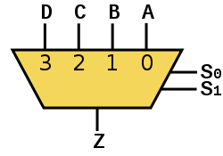
MUX Review
A MUX has n select lines, 2^{n} inputs and 1 output
The select line chooses which input to pass to the output
Truth table (4:1 MUX)
S0 | S1 | Output (Z)
0 | 0 | A
0 | 1 | B
1 | 0 | C
1 | 1 | D

Slide 4
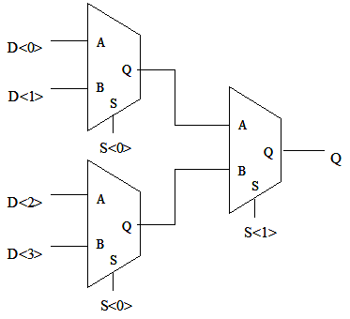
4-to-1 MUX from three 2-to-1 MUX’s

Slide 5
What is a Parity Generator?
Circuit that outputs either a 0 or a 1 depending on the number of 1’s in the input
Types
Even – outputs a 1 if there is an odd number of 1’s in the input (i.e. the total # of 1’s becomes even)
Odd – outputs a 1 if there is an even number of 1’s in the input (i.e. the total # of 1’s becomes odd)

Slide 6
3-bit Parity Generator Truth Tables
Even
Odd
X | Y | Z | Parity
0 | 0 | 0 | 0
0 | 0 | 1 | 1
0 | 1 | 0 | 1
0 | 1 | 1 | 0
1 | 0 | 0 | 1
1 | 0 | 1 | 0
1 | 1 | 0 | 0
1 | 1 | 1 | 1
X | Y | Z | Parity
0 | 0 | 0 | 1
0 | 0 | 1 | 0
0 | 1 | 0 | 0
0 | 1 | 1 | 1
1 | 0 | 0 | 0
1 | 0 | 1 | 1
1 | 1 | 0 | 1
1 | 1 | 1 | 0

Slide 7
Lab Exercise
Create either an even or odd 3-bit parity generator using your 4:1 multiplexer
Simulate your circuit

Slide 8
Analysis
Test your parity generator for all possible 3-bit combinations
Show the output waveforms for each test
What is the application of a parity generator?

Slide 9
Homework
Implement a 1-Bit full adder using the 4:1 multiplexer (hint: you will need two 4:1 MUX’s, one for sum and another for carry)
Simulate your adder
You should test your circuit for all possible combinations of input

