Slide 1
ECE 3130 – Digital Electronics and Design
Lab 2
Adders and Multiplexers
Fall 2012

Slide 2
Objectives
Learn how adders and multiplexers work
Build and simulate a half and full adder
Build and simulate a 2-to-1 and 4-to-1 multiplexer

Slide 3
What are adders?
Digital circuits that perform addition of numbers
Half adder
Adds two 1-bit binary numbers
Full adder
Adds three 1-bit binary numbers

Slide 4
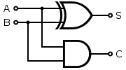
Half Adder
Truth table
Implementation
A | B | Sum | Carry
0 | 0 | 0 | 0
0 | 1 | 1 | 0
1 | 0 | 1 | 0
1 | 1 | 0 | 1

Slide 5
Full Adder
Truth table
A | B | C | Sum | Carry
0 | 0 | 0 | 0 | 0
0 | 0 | 1 | 1 | 0
0 | 1 | 0 | 1 | 0
0 | 1 | 1 | 0 | 1
1 | 0 | 0 | 1 | 0
1 | 0 | 1 | 0 | 1
1 | 1 | 0 | 0 | 1
1 | 1 | 1 | 1 | 1

Slide 6
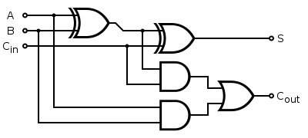
Full Adder Implementation
Implementation

Slide 7
Analysis
In addition to the truth table, include the Boolean equation for the sum and carry of the half and full adder.
Report, in tabular form, the propagation delays (t_{PHL}, t_{PLH}) of the sum and carry for the half adder.
Which output has longer delay: sum or carry? Can you say why?

Slide 8
What is a multiplexer (MUX)?
A device with multiple inputs and one output
Also known as a data selector or controlled switch

Slide 9
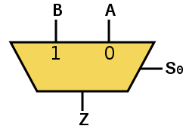
How does it work?
A MUX has n select lines, 2^{n} inputs and 1 output
The select line chooses which input to pass to the output
2-to-1 MUX
Truth table
S | A | B | Z
0 | 0 | 0 | 0
0 | 0 | 1 | 0
0 | 1 | 0 | 1
0 | 1 | 1 | 1
1 | 0 | 0 | 0
1 | 0 | 1 | 1
1 | 1 | 0 | 0
1 | 1 | 1 | 1

Slide 10
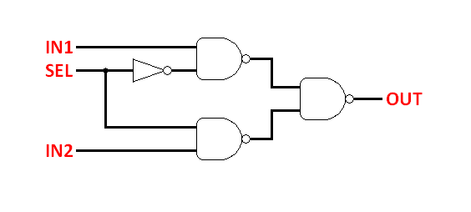
2:1 MUX Gate Implementation

Slide 11
4-to-1 MUX
Truth table
S1 | S2 | Output (M)
0 | 0 | A
0 | 1 | B
1 | 0 | C
1 | 1 | D

Slide 12
Homework
Build a 2:1 MUX and simulate it
Build a 4:1 MUX from your 2:1 MUX (hint: you will need three 2:1 MUX’s) and simulate it
You will be using the 4:1 MUX next lab

