Slide 1
ECE 3130 – Digital Electronics and Design
Lab 1
Introduction to Tanner Tools
Fall 2012

Slide 2
Objectives
Review basic digital circuit concepts
Develop an understanding of digital circuit design and simulation
Learn the basics of the Tanner Tools software

Slide 3
How do digital circuits work?
Analog – continuous signal
Digital – discrete signal
Fundamentally binary devices
Quantization of voltage
HIGH
LOW

Slide 4
Generic Voltage Transfer Characteristics
Input
IN ≤ VIL → “0”
IN ≥ VIH → “1”
Output
OUT ≤ VOL → “0”
OUT ≥ VOH → “1”

Slide 5
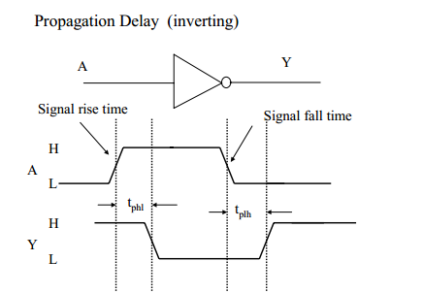
Propagation Delay (t_{P})
When the gate inputs change, the outputs do not change instantaneously
Defined as the latency between a change in the input and a change in the output measured from the 50% point at the input and the 50% point at the output
t_{PHL} – the time it takes for the output to switch from HIGH to LOW
t_{PLH} – the time it takes for the output to switch from LOW to HIGH

Slide 6
Logic Gates
AND
OR
NOT (a.k.a. inverter)
NAND
NOR
XOR
XNOR

Slide 7
Introduction to MOSFETS
Four terminal devices
Gate
Source
Drain
Body
Two types
PMOS – source connected to V_{HIGH}
NMOS – source connected to V_{LOW}
*NOTE*: The body is always shorted to the source in both devices

Slide 8
Tanner Tools Components
5 Modules
L-Edit
LVS
S-Edit
T-Spice
W-Edit

Slide 9
Let’s Start…
Start → All Programs → Tanner EDA → Tanner Tools v15.0 → S-Edit v15.0 64-bit

Slide 10
This is the startup interface

Slide 11
Make a new design file

Slide 12
Name the design
Create a directory to store your files and set the path

Slide 13
Make a new cell

Slide 14
Name the cell and select schematic

Slide 15
This is the schematic workspace

Slide 16
Add the following libraries:
C:\Users\Student\Documents\Tanner EDA\Tanner Tools v15.0\Process\Generic_250nm\Generic_250nm_Devices\Generic_250nm_Devices.tanner
C:\Users\Student\Documents\Tanner EDA\Tanner Tools v15.0\Process\Standard_Libraries\Misc\Misc.tanner

Slide 17
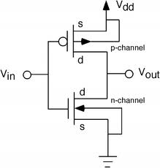
Inverter
Truth table
Implementation
Input | Output
0 | 1
1 | 0

Slide 18
Select the devices library
Select the desire component from the parts list
Press “Instance”

Slide 19
Select 4T
Left-click to place on grid then click Done

Slide 20
Wire
In
Out
Vdd and Gnd are found in the Misc library

Slide 21
Now let’s make a symbol for the inverter

Slide 22
Select the same cell as your schematic
Select “symbol” from view
Click OK

Slide 23
This is the symbol workspace.
Let’s have Tanner generate a symbol for us.

Slide 24
Make sure the Design and Cell are correct and then hit “Replace”

Slide 25
Pointer
This is the auto-generated symbol but let’s make it better.
Pick the Pointer tool, select the box, and press Backspace to delete it

Slide 26
Path
All angle
Pick the “Path” tool and “All angle” selection
Draw the standard logic symbol for an inverter
Draw “paths” to connect everything

Slide 27
Building the Test Bench
Make new design file
Call it inverter_test
Add the inverter library, which you just made
Add the following libraries
C:\Users\Student\Documents\Tanner EDA\Tanner Tools v15.0\Process\Standard_Libraries\SPICE_Commands\SPICE_Commands.tanner
C:\Users\Student\Documents\Tanner EDA\Tanner Tools v15.0\Process\Standard_Libraries\SPICE_Elements\SPICE_Elements.tanner

Slide 28
Voltage source is found in the SPICE_Elements library
Print Voltage is found in the SPICE_Commands library
Capacitor is found in the Devices library
Voltage source (pulse)

Slide 29
C:\Users\Student\Documents\Tanner EDA\Tanner Tools v15.0\Process\Generic_250nm\Generic_250nm_Tech\Generic_250nm.lib TT
Press this button to set up the simulation

Slide 30
Set the stop time and maximum time step and hit Run Simulation

Slide 32
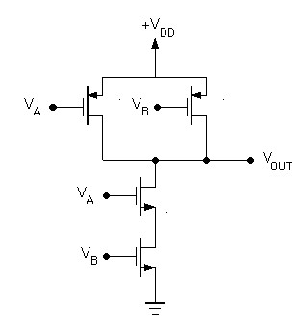
NAND Gate
Truth table
Implementation
A | B | Output
0 | 0 | 1
0 | 1 | 1
1 | 0 | 1
1 | 1 | 0

Slide 36
Analysis
Tabulate the propagation delays (t_{PHL}, t_{PLH}) for the inverter and NAND gate.
Record the waveforms.

