Slide 1
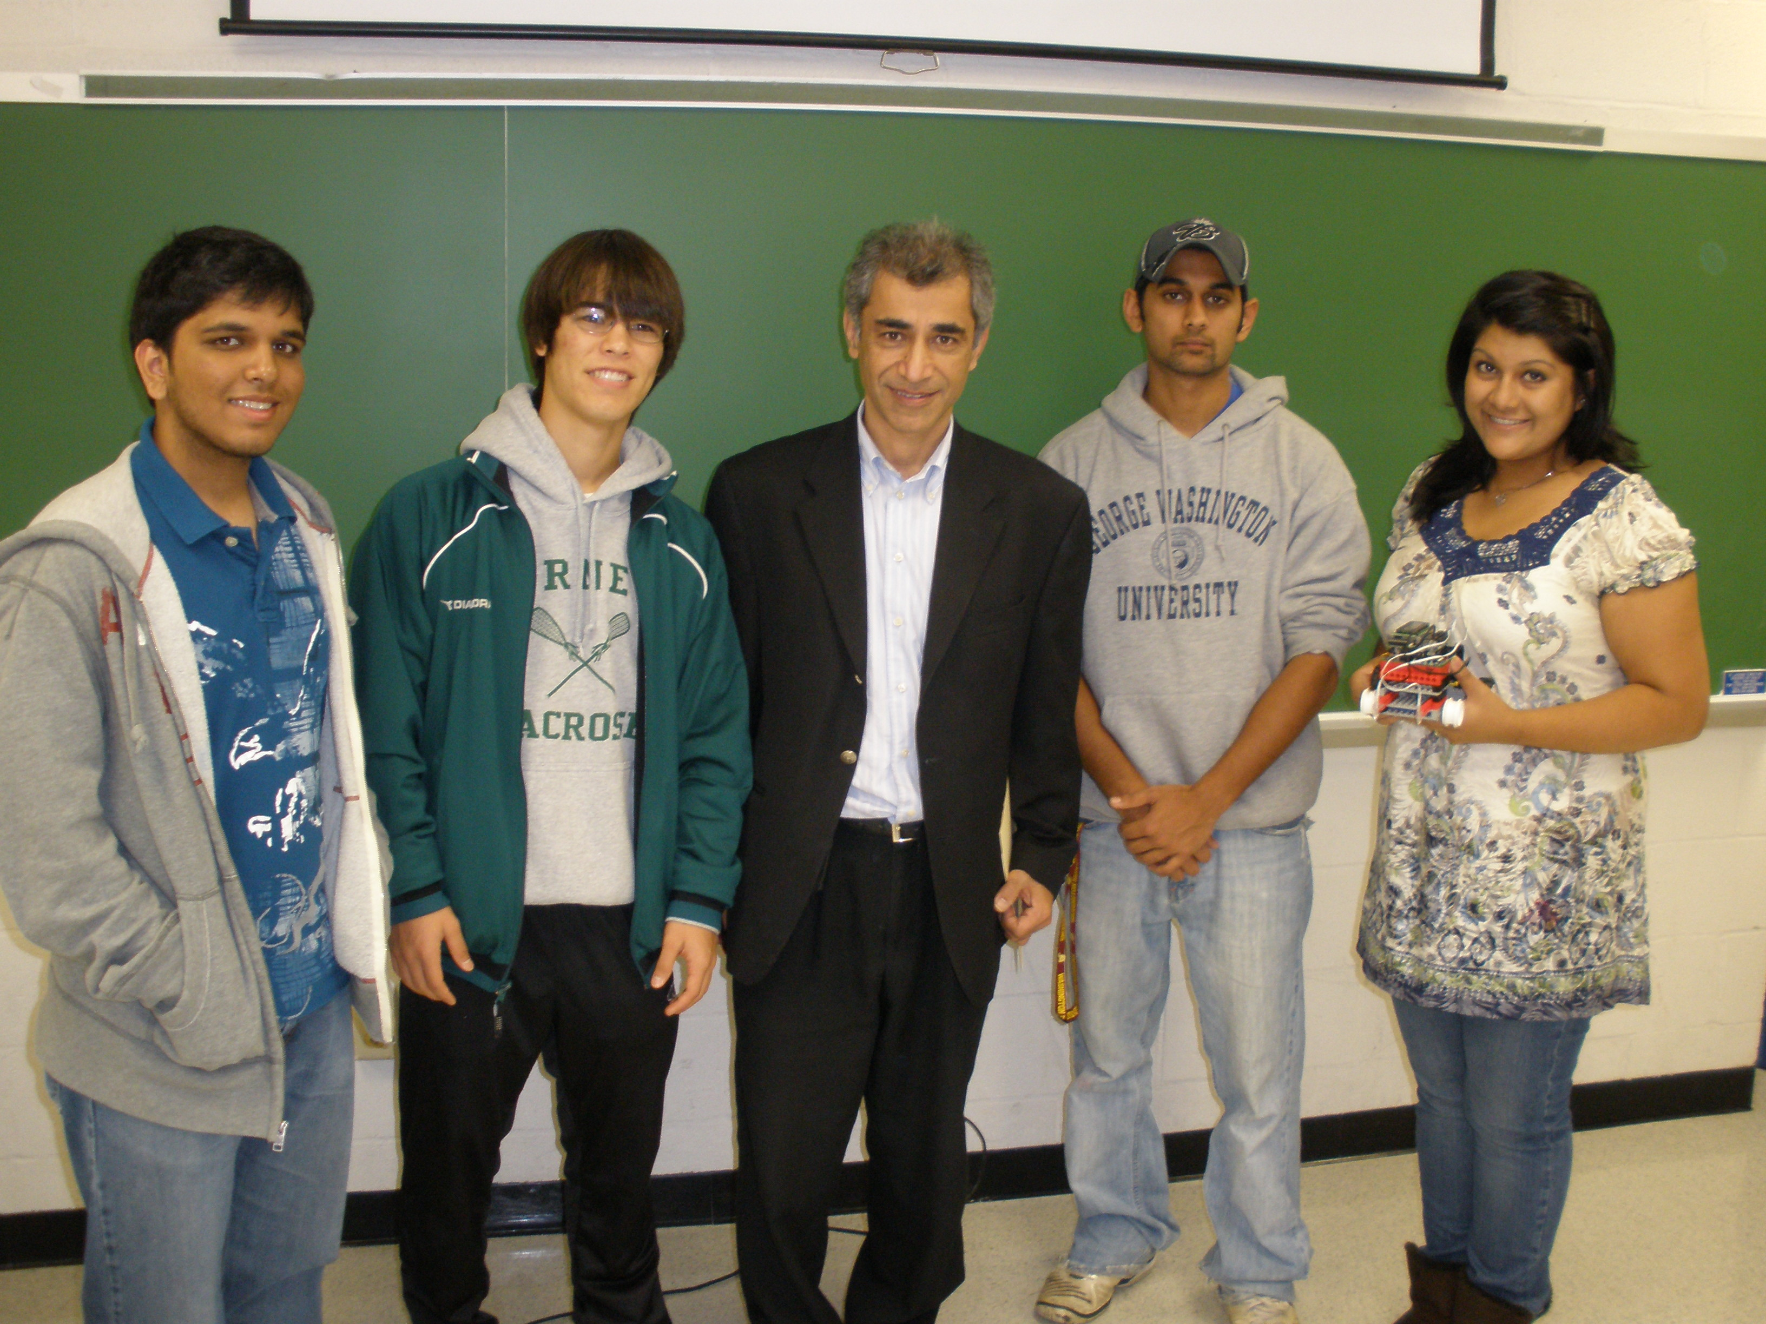
Build-a-Bot… Group 7 Style!
From left to right: Zahin Hasan, Taylor Hubbard, Professor Ahmadi, Rahul Gupta, Asifa Habib
Group Name: Autonomous Anonymous

Slide 2
Objective
Robot
The objective was to build a robot that could move along a black S-shaped path from the starting point to the end point. Once the robot reached the end point, it should be able to execute a U-turn and return down the same path back to the starting point.
Centrifuge
Design and code a centrifuge that can accelerate to a point where oil and water separate

Slide 3
Resources Needed
Handyboard (charged)
Two motors
Two light sensors
Four medium-sized wheels (two with the rubber tires removed)
Two large gears, two medium gears
Various Lego pieces to construct chassis/frame
Scotch tape to secure light sensors to our robot

Slide 4
Procedures
Designed and built to be light and compact yet have a good amount of torque. (generated by medium to large gear ratio)
Rear-wheel drive system with one motor on each back wheel.
Rubber tires on front wheels removed to minimize friction when turning.

Slide 5
Procedures (Cont.)
Handyboard was placed on top of the frame of our robot and then was fastened to the frame with Lego parts.
Light sensors were fastened to two arms that protruded out in front of our robot. This allowed them to take their readings without any interference from the shadow of our robot.

Slide 6
Our Robot: Autonomous Prime

Slide 7
Robot Source Code
Four our code we used three while loops.
For each while loop we defined a new control variable (i.e. control=1, control=2, control=3) .
To break out of the while loop and enter our u-turn we used a break function. (i.e. if((sensor1>=50)&&(sensor3>=50)) break;) This tells the robot to break out of the loop it was in and proceed in reading the rest of the code
We used two light sensors for our robot in which we define as sensor1 and sensor3.

Slide 8
Robot Source Code (Cont.)
When both sensors read a threshold of > 50 for the first time (the finish line) our robot would break out of the first loop and enter our second loop which was to back up, turn for 1.2 seconds and then enter our third and final loop which was basically identical to our first loop which was used to follow the line.
To determine the right thresholds for our light sensors and the right time to sleep while turning in our u-turn loop, our group had to do a lot of trial and error testing.
We came up with our final code by getting ideas from our homework codes, compiling and combining numerous parts.

Slide 9
Preparing to Download our Code

Slide 10
Challenges
Turning Capability- Our robot when first put together could not turn smoothly. As a result we removed the rubber tires from the two front wheels to reduce the friction caused when implementing a turn.
Size of robot- Our robot chassis started off too heavy with too many unnecessary pieces. We had to restructure our chassis numerous times to make it more compact and light weight. This improved speed and maneuverability.

Slide 11
Challenges (cont.)
U-turn- The programming for the u-turn gave our team the most trouble. We could not figure out how to get our program to leave our initial loop and enter our u-turn loop. After reseaching the topic, Rahul ended up coming up with the solution to this problem which was the break function.
Handyboard- The were numerous times when our handyboard had not been fully charged and would die on us during class. We then were forced to either borrow another groups handyboard or wait and have our handyboard charge again. Both options ended up wasting a good amount of our time.

Slide 12
Working Hard to get the Job Done

Slide 14
Biomedical Experiment Discussion
Centrifuges are used to separate the contents of a solution by density.
In the biomedical field, researchers are required to do such experiments to find vaccines. They also use centrifuges in order to prepare serums and plasma from blood. They are also able to help scientists measure and separate proteins and certain viruses.

Slide 15
Construction of our Centrifuge
For the construction of our centrifuge, we utilized the same handyboard, motors, and Lego pieces used towards our robot.
Our centrifuge consisted of one motor that had a large gear directly attached to it. The large gear then threaded with a smaller gear that was attached to a vertical axle that would spin.
The large to small gear ratio allowed maximum speed.

Slide 16
Construction (cont.)
At the top of the vertical axle was a rod that was fastened to the axle perpendicularly.
Two free spinning arms were then placed and secured on the perpendicular rod, one to attach a weight to and one to attach the tube of oil solution.
Finally, the program was implemented so that when the start button on the handyboard was pressed, the axle would start to spin and slowly accelerate until it was spinning at full speed [motor(1, 100)].

Slide 17
Testing our Centrifuge Design

Slide 18
Assembling and Programming our Centrifuge

Slide 19
Final Centrifuge Model

Slide 20
Conclusion
From our projects we were able to learn how to generate programs through Interactive C and use them to operate mechanical devices (i.e. our robot and centrifuge)
We learned valuable teamwork skills and successfully completed our objectives.

Slide 21
The End

