Slide 1
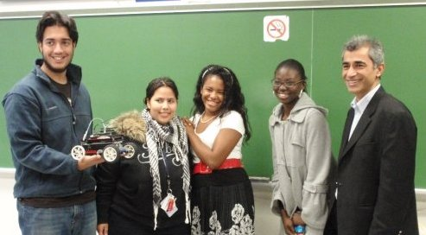
Group #1 Project ECE 001 ’08 Team Extreme
(Left to Right) Mohammad Akhavanni, The Tank,
Meriam Abisourour, Esther Akinnagbe, Marian Ackun, Professor Ahmadi

Slide 2
Project Objective
Project 1: To build and program a robot that will follow a solid black line, make a U-turn, and follow the line back to the start.
Project 2: To understand the mechanics of a centrifuge and perform an experiment.

Slide 3
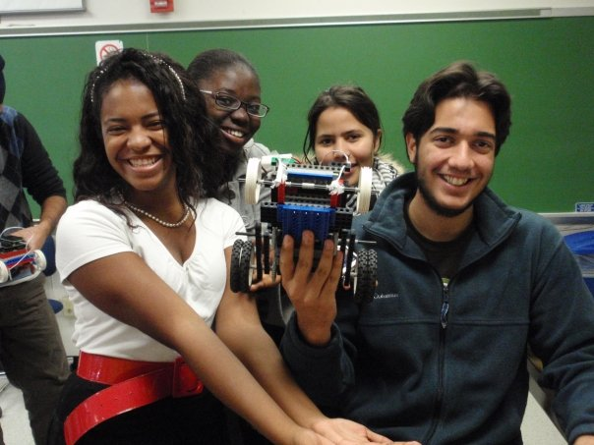
Resources Required for Robot
Materials:
Handy-board #1
2 Motors
2 Light Sensors
Lego pieces

Slide 4
Robot Source Code Part 1: Following The Black Line
//Program to follow and detect black line, make a u-turn, and follow line to the start
//motor 1=left, motor 3=right. sensor 1=left, sensor 2=right
void main() { int sensor1; int sensor2; int Flag=1; /*Integer to set different stages of the program (stage 1: go to end of black line, stage 2: u-turn, stage 3: come back)*/ int x=170; //170 determines the threshold between white and black surfaces while(!start_button()); //wait until start-button is pressed while(Flag==1) //infinite loop { if((analog(5)<=x)&&(analog(6)<=x)) /*program for when both sensors detect white: both motors continue straight*/ { motor(1,50); motor(3,50); } if((analog(6)<x)&&(analog(5)>=x)) //right sees white left sees black: turn left { motor(1,-50); motor(3,100); } if((analog(5)<x)&&(analog(6)>=x)) //right sees black left sees white: turn right { motor(1,100); motor(3,-50); } if((analog(5)>=x)&&(analog(6)>=x)) // both sensors detect black: all motors off for u-turn and end of infinite limit { ao(); Flag=0; } }

Slide 5
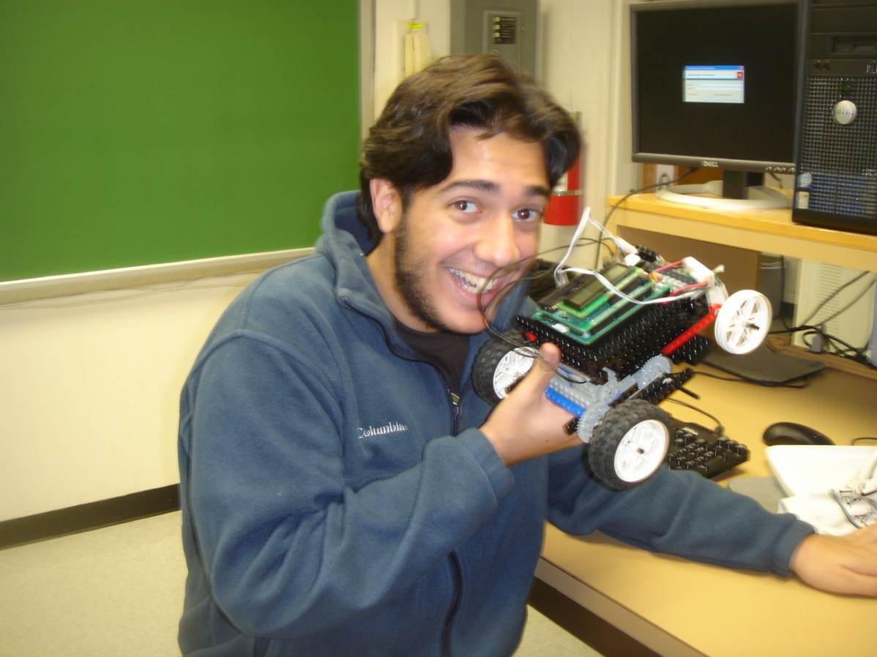
Robot Source Code Part 2: The U-turn
motor(1,-100);
motor(3,100); sleep(1.0); ao(); sleep(1.5); while(analog(6)<170) { motor(1,-75); motor(3,75); } ao(); sleep(0.5); Flag=2;
//integer redefined to start second infinite loop

Slide 6
Robot Source Code Part 3: The Return to the Star
while(Flag==2)
{ if((analog(5)<=x)&&(analog(6)<=x)) // program for when both sensors detect white: both motors continue straight { motor(1,50); motor(3,50); } if((analog(6)<x)&&(analog(5)>=x)) //right sees white left sees black { motor(1,-50); motor(3,100); } if((analog(5)<x)&&(analog(6)>=x)) //right sees black left sees white { motor(1,100); motor(3,-50); } if((analog(5)>=x)&&(analog(6)>=x)) // both sensors detect black: all motors off for u-turn and end of infinite limit { motor(1,0); motor(3,0); ao(); Flag=3; } }
while(Flag==3) // infinite victory beeps
{ ao(); beep(); } }

Slide 7
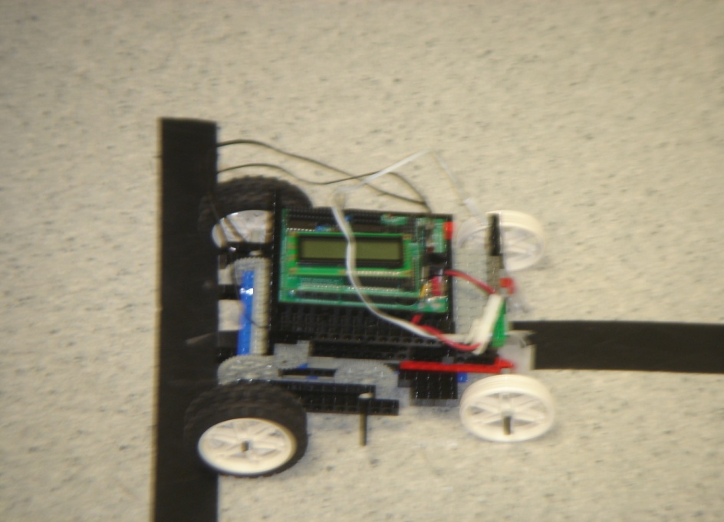
Procedure to Implement Design
Theme: The American Dream: Bigger is Better.
Wheels:
No treads
4 in back instead of 2
Front wheels no tires
Speed:
Beginning: High
Middle: 75
End: Low
.:
Light Sensors
Focusing and Positioning of
Job Distribution:
Software design: Mohammad
Robot Building: Meriam, Esther, and Marian
Order of Development:
At first, we built the robot and wrote the program simultaneously,
Robot:
We first constructed the robot with a heavy platform and the motors attached to the bottom
Then the platform was just as heavy, but sturdier and the handy-board was now positioned in a way so it was weighing down on the motors to keep them steady.
At first only two back wheels
Then 4
Finally, after the robot was built, the sensors were placed and tested along with the program.

Slide 8
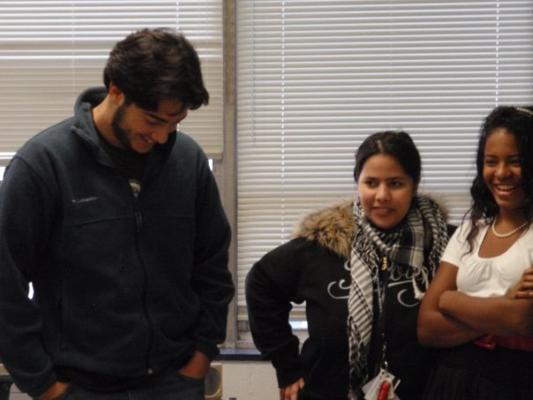
Challenges Faced:
Testing due to no Robot.
Communication Problems
Robot Problems
Week motors
Heavy Robot
Optimum speed
Optimum distance
of sensors

Slide 9
End Product: The Tank Lives
All in all, the project was successful and we were able to complete all the requirements albeit a couple of breakdowns and stressful moments. In the end, we all stood proud and watched our Tank make it around the bends and cross the finish-line.

Slide 10
Biomedical Experiment
/*program for centrifuge to increase speed, remain turing at maximum speed, then decrease speed gradually*/
void main()
{
int i;
int s;
for (i=10; i<=10; i=i+10)
{
motor(0,i);
motor(o.3);
}
beep();
sleep(5.0);
beep();
for(i=10; i<=100; i=i+10)
{
s=100-i;
motor(0,s);
sleep(0.3);
}
beep();
}
//program to read transmittance
void main()
{
int read;
while(1)
{
read=analog(5);
printf("\n%d", read);
sleep(0.4);
}
}

Slide 11
Biomedical Experiment
Spreadsheet
Trial # | Sensor Reading (Before Separation) | Sensor Reading (After Separation) |  | Ramp Up Time (sec) | Ramp Down Time (sec) | Separation Time (sec)
 |  | Oil | Water
1 | 170 | 142 | 230 | 3.8 | 3 | 5.1
2 | 150 | 150 | 200 | 3.36 | 3.1 | 5.1
3 | 153 | 160 | 190 | 3.76 | 2.8 | 4.7
4 | 152 | 142 | 191 | 3.33 | 4 | 3.13
5 | 175 | 120 | 180 | 3.57 | 3.08 | 5.05
Motor percentage versus Speed

Slide 12
Conclusion
Building our robot took a lot more trials then expected
We had to rebuild the robot to secure the software and the motors at least once
The programming for the robot took less time, but it still required a lot of testing

