Slide 1
Robot Base
All images were taken from KIPR DemoBot guide.

Slide 2
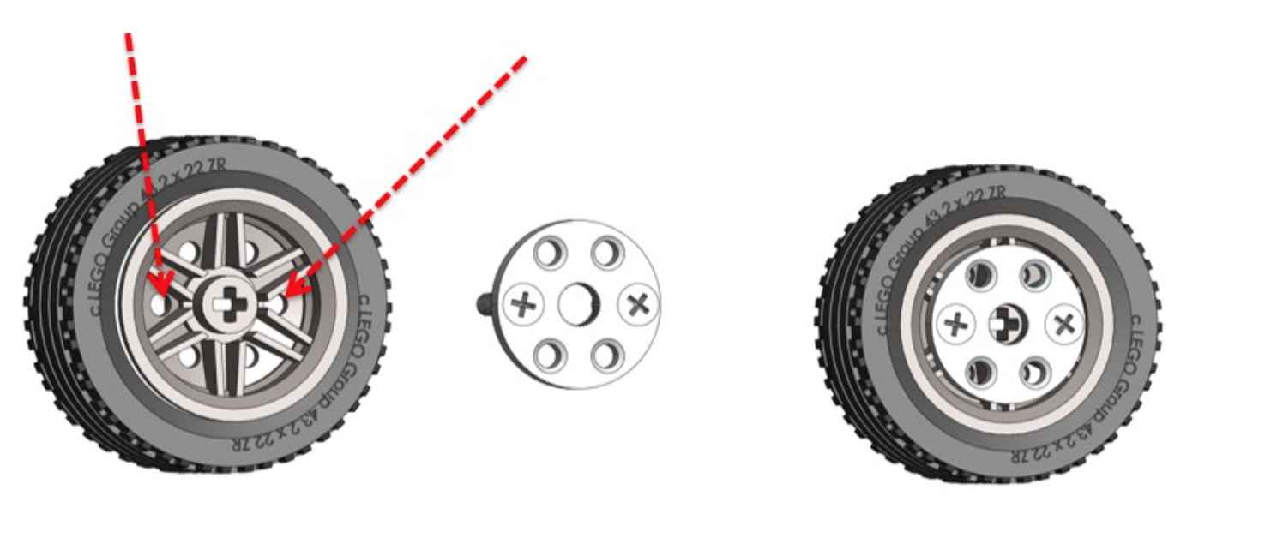
Side Wheels

Slide 3
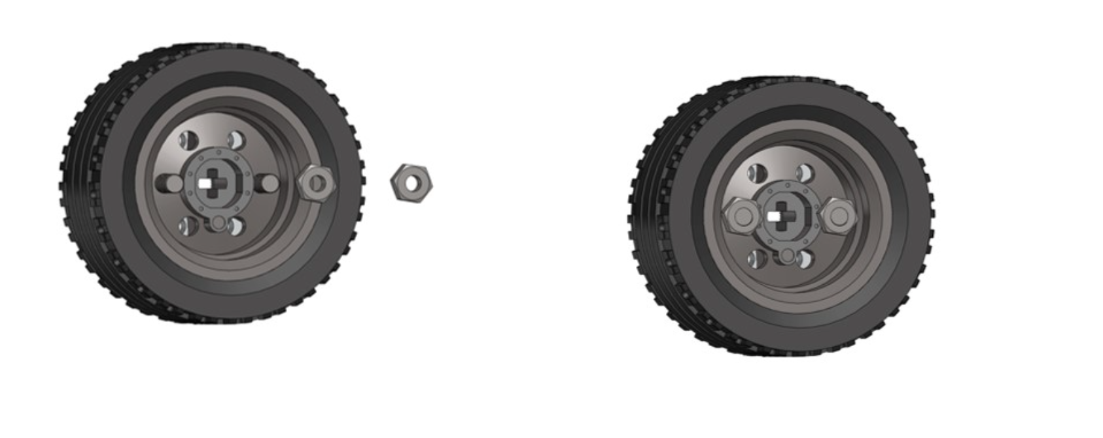
Side Wheels

Slide 4
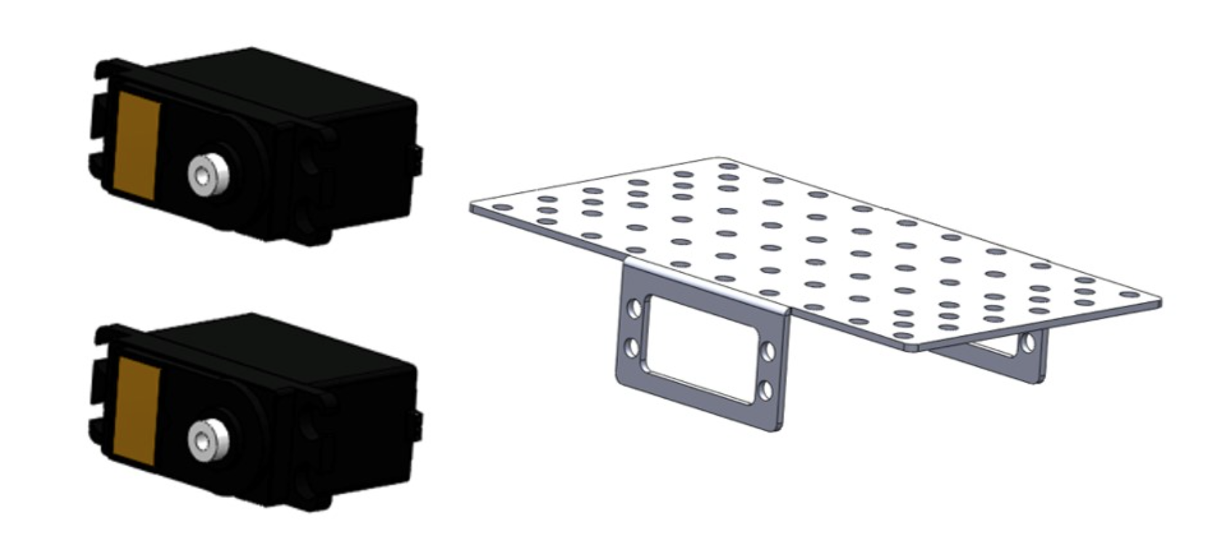
Base&Motors

Slide 5
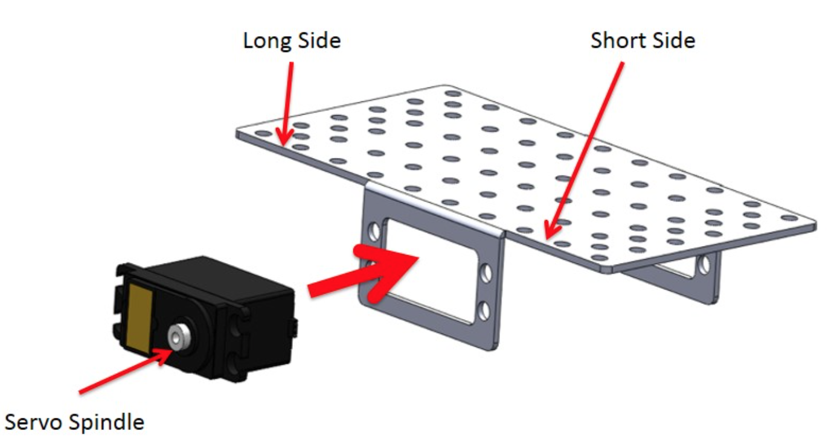
Base&Motors

Slide 6
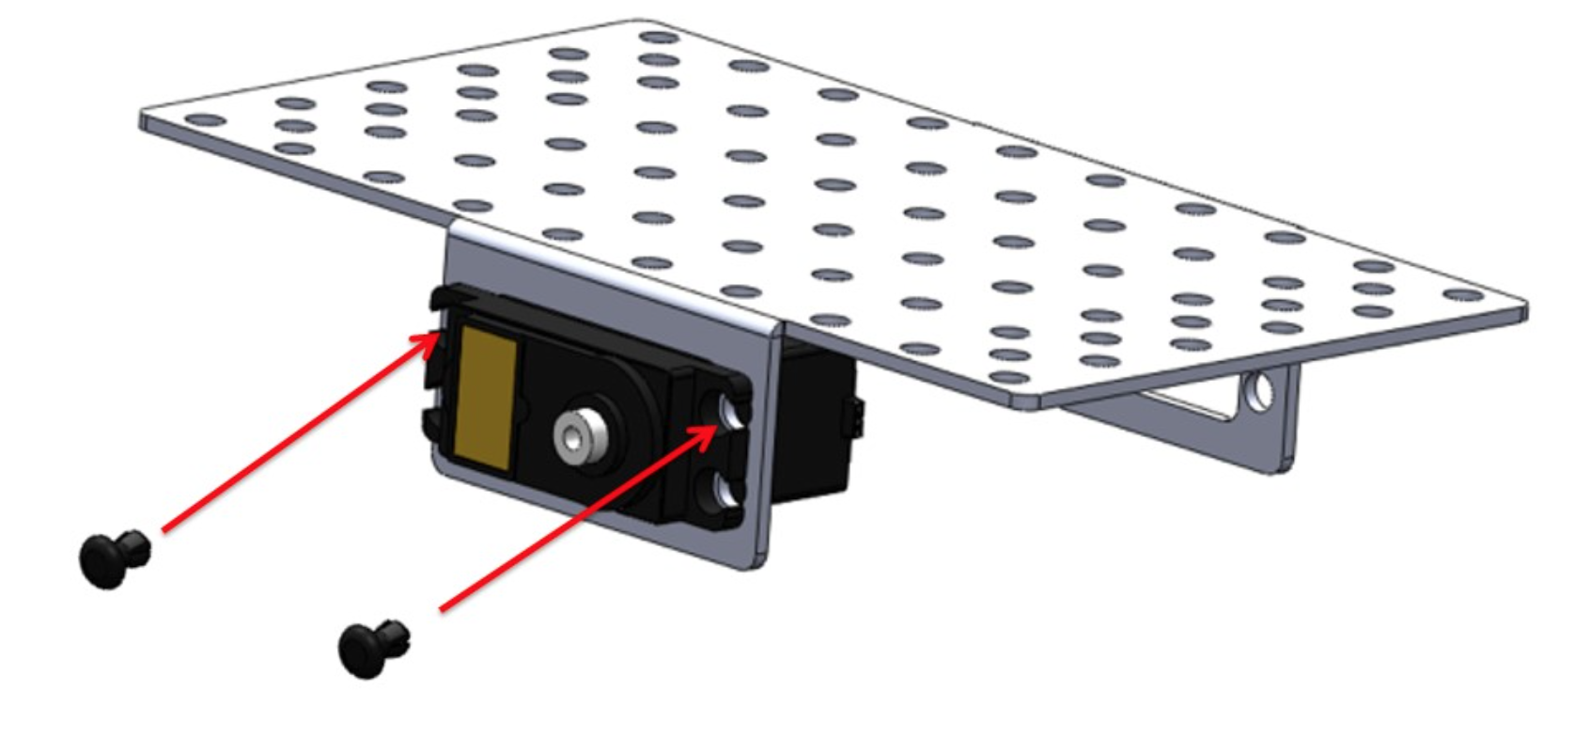
Base&Motors

Slide 7
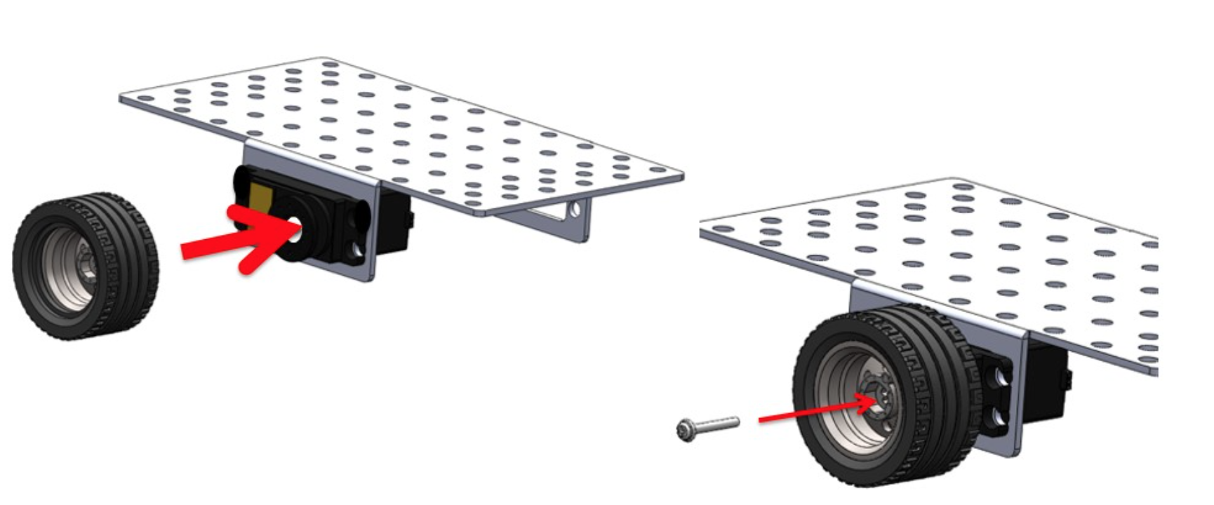
Base&Motors

Slide 8
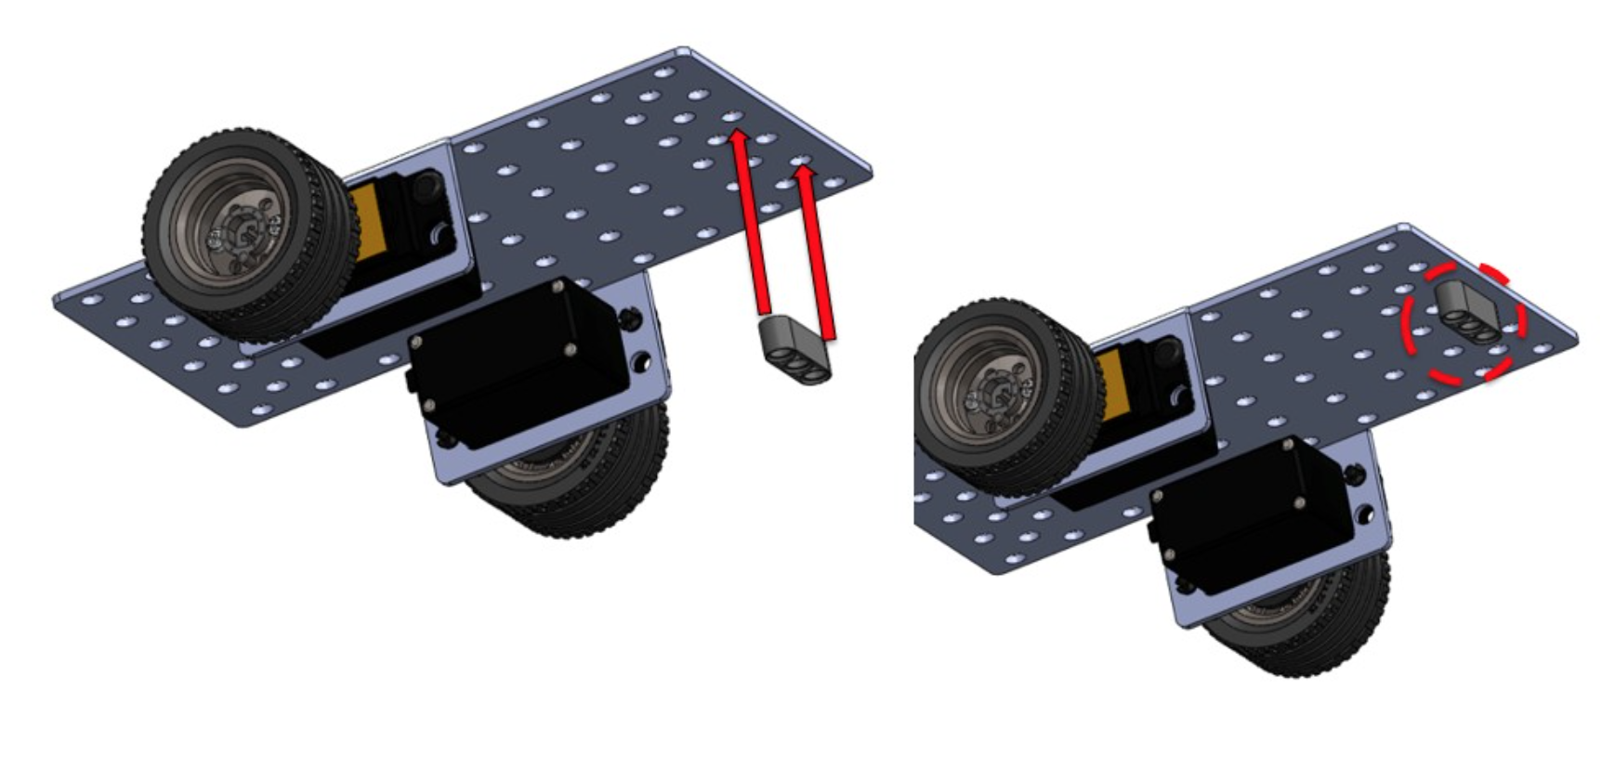
Front Wheel

Slide 9
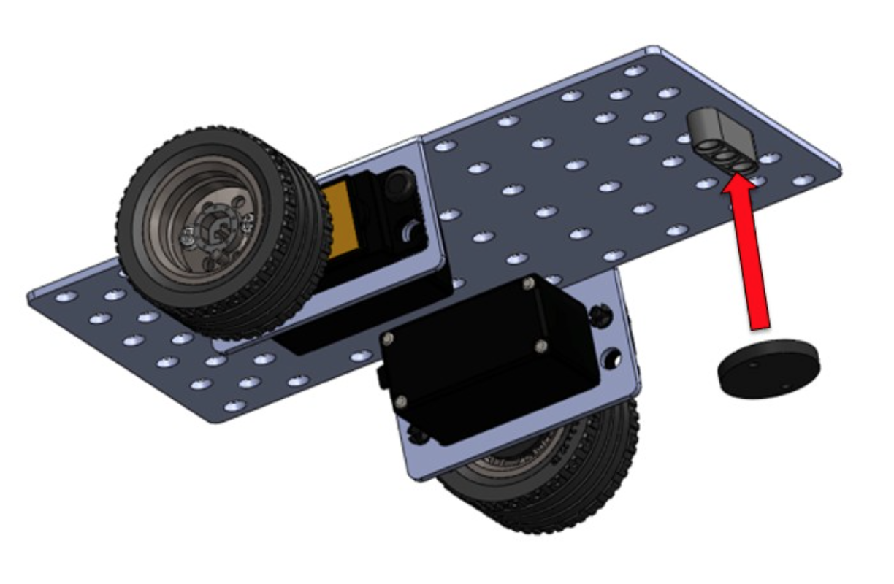
Front Wheel

Slide 10
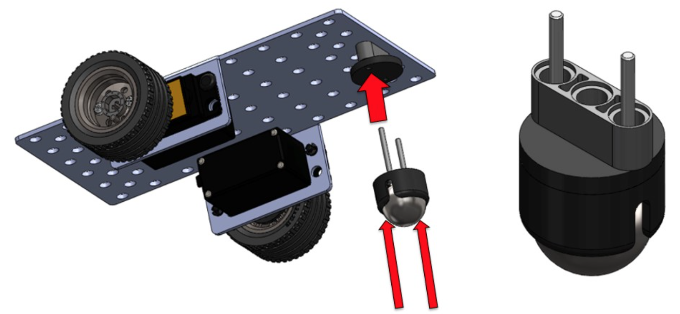
Front Wheel

Slide 11
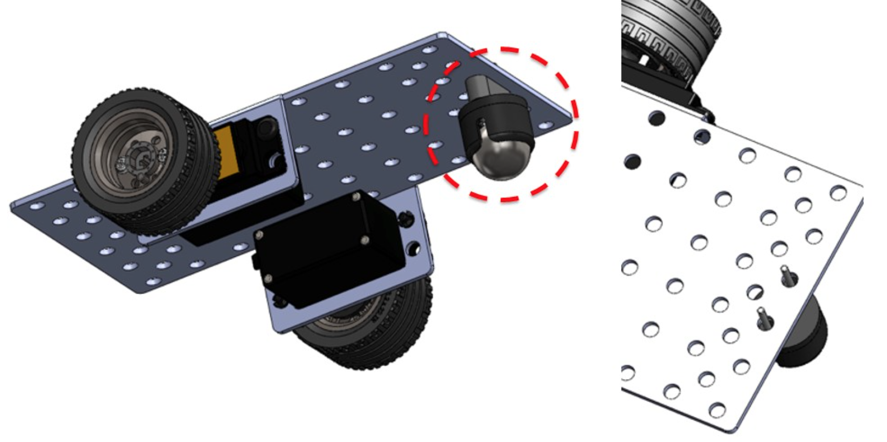
Front Wheel

Slide 12
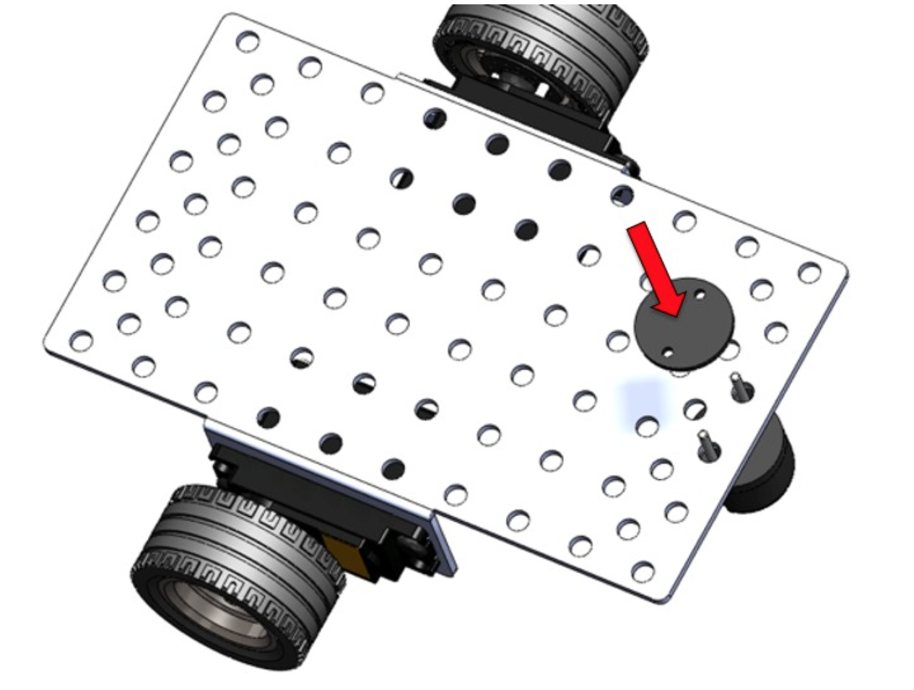
Front Wheel

Slide 13
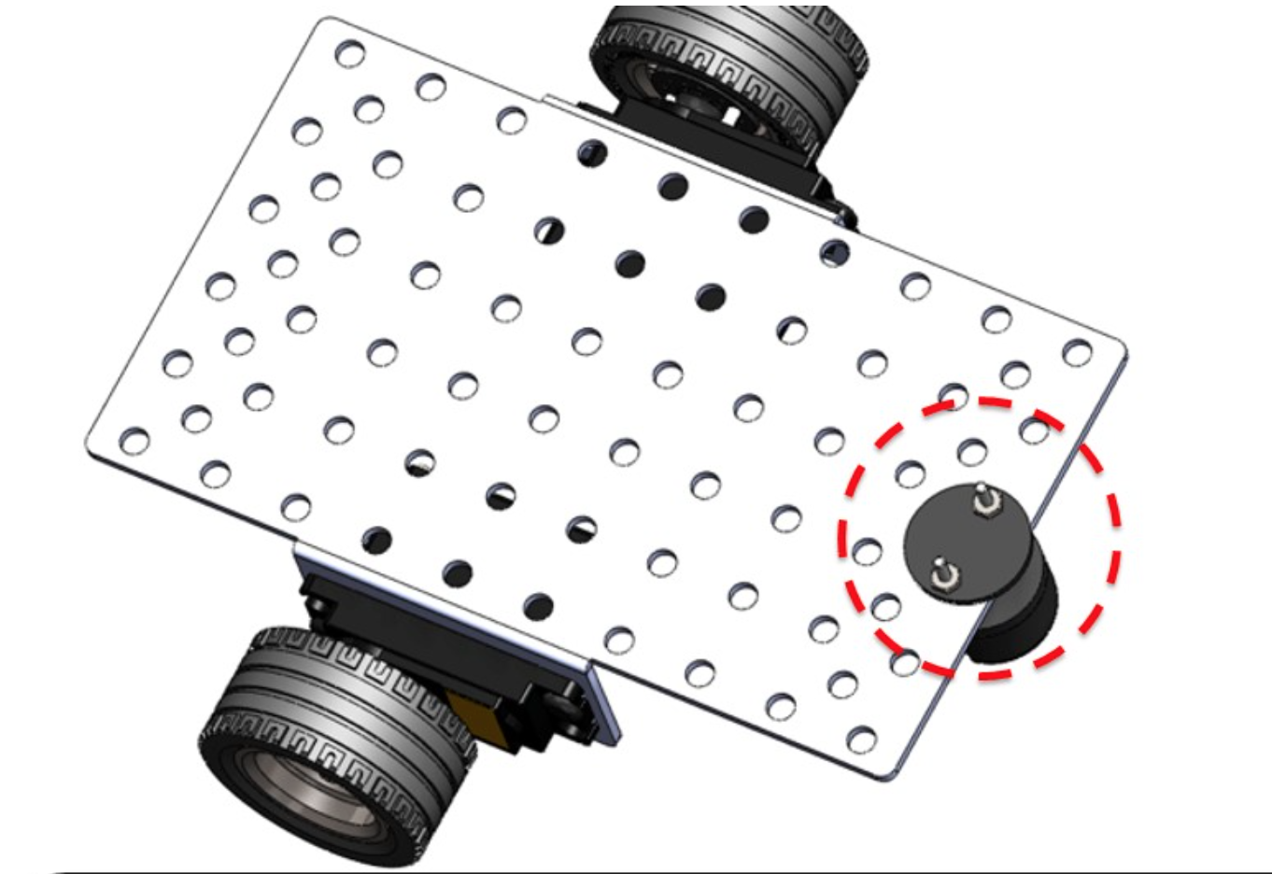
Front Wheel

