Slide 1
Preliminary Future Scenario - Definition
Presentation by: J. Rene van Dorp
GWU Personnel: Dr. J. Rene van Dorp
VCU Personnel: Dr. Jason R. W. Merrick
April 2, 2013
Notes:
1

Slide 2
2010 VTRA STUDY – FUTURE PROJECT + FOCUS VESSELS
BASE CASE: VTRA UPDATED WITH VTOSS 2010
FOCUS VESSEL | VESSEL TYPE
1 | Oil Tanker
2 | ATB
3 | Oil Barge
4 | Bulk Carrier
5 | Container Vessels
FUTURE | SCENARIO
1 | GATEWAY
2 | KINDER MORGAN
3 | DELTA TERMINAL
4 | OTHER TRENDS
SUGGESTED APPROACH TOWARDS FUTURE SCENARIO DEFINITION:
Keep interacting vessels at VTOSS 2010 levels, limit to FV changes
Each Scenario may result in Focus Vessel increases
Each Scenario may result in Focus Vessel decreases

Slide 3
2010 VTRA STUDY – 10 FUTURE SCENARIOS THUS FAR
SCENARIOS | TRENDS | GW ⇑ | KM ⇑ | DP ⇑
BASE: VTRA 2010 | NO | NO | NO | NO
VTRA 2010 + TRENDS | YES | NO | NO | NO
GW - NT | NO | YES | NO | NO
GW - YT | YES | YES | NO | NO
KM - NT | NO | NO | YES | NO
KM - YT | YES | NO | YES | NO
DP – NT | NO | NO | NO | YES
DP - YT | YES | NO | NO | YES
MAX HIGH - NT | NO | YES | YES | YES
MAX HIGH - YT | YES | YES | YES | YES

Slide 4
1 BASE CASE + 9 FUTURE SCENARIOS
Recall: We evaluate exposure, accident frequency and oil outflow
5 Focus Vessels
10 Scenarios
3 Output Metric Profiles
Number of Geographic Profiles: 5 x 10 x 3 = ??
150 Geographic Profiles
50 Exposure, 50 Accident Frequency, 50 Oil Outflow Profiles
To help inform risk mitigation strategies
BASE CASE PROFILES: FIRST WEEK OF MAY
FUTURE PROFILES : FIRST WEEK OF JUNE

Slide 5
Future Scenario 1 GATEWAY
Presentation by: J. Rene van Dorp
GWU Personnel: Dr. J. Rene van Dorp
VCU Personnel: Dr. Jason R. W. Merrick
APRIL 2, 2013
Notes:
5

Slide 6
2010 VTRA STUDY – GATEWAY PROJECT TRAFFIC INCREASES
Focus Vessel | Call Increases | SOURCE/ ANALYSIS
1 | Oil Tanker : None
2 | ATB : None
3 | Oil Barge : + 228 | At current rate of bunkering: see b elow
4 | Bulk Carrier : + 487 | Gateway Project Information Document
5 | Container Vessels: None
http://www.whatcomcounty.us/pds/plan/current/gpt-ssa/pdf/2011-02-28-project-info-doc.pdf

Slide 7
2010 VTRA STUDY – GATEWAY PROJECT TRAFFIC DECREASES
Focus Vessel | Call Decreases | SOURCE/ ANALYSIS
1 | Oil Tanker : None
2 | ATB : None
3 | Oil Barge : None
4 | Bulk Carrier : None
5 | Container Vessels: None

Slide 8
2010 VTRA STUDY – GATEWAY PROJECT TRAFFIC DECREASES

Slide 9
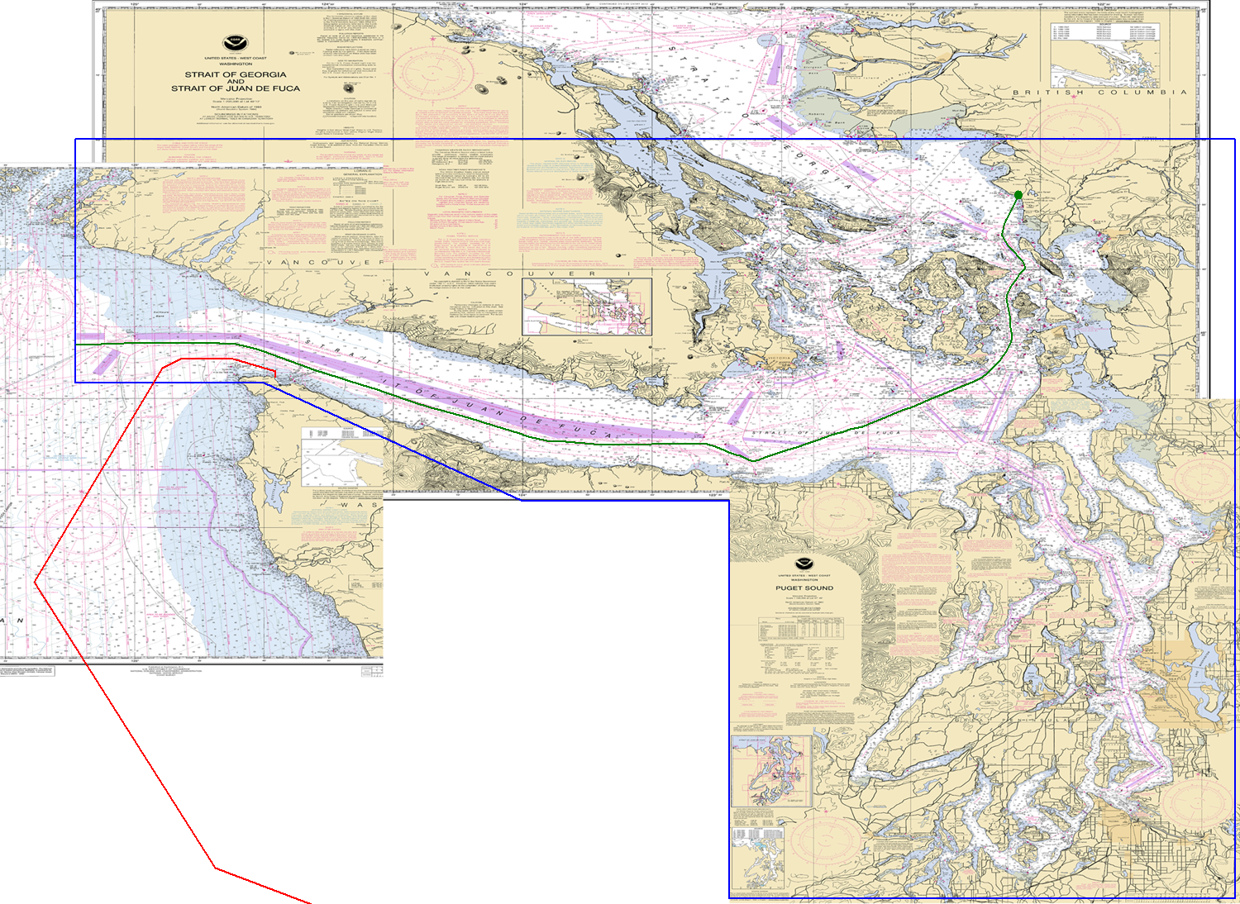
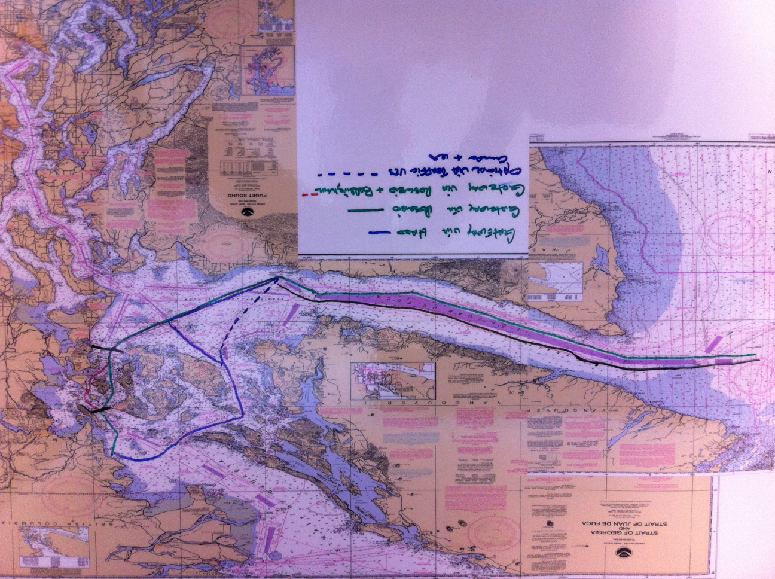
POTENTIAL ROUTES FOR FUTURE GATEWAY TRAFFIC
THANK YOU PUGET SOUND PILOTS!
INBOUND ROUTES:
GATEWAY VIA ROSARIO
GATEWAY VIA HARO
Optional via traffic VTS
GATEWAY VIA ROSARIO + BELLINGHAM
OUTBOUND ROUTES:

Slide 10
2010 VTRA STUDY – GATEWAY PROJECT TRAFFIC DECREASES
WILL NEED TO WORK TOGETHER WITH STEERING COMMITTEE TO GET A
GENERAL PICTURE OF
BUNKERING OPERATIONS
TO BE ABLE TO MODEL
BUNKERING INCREASES IN GW/VCU SIM VTRA MODEL
WOULD LIKE TO SUGGEST
MEETINGS IN FIRST WEEK
WEEK OF MAY (1st, 2nd or 3rd)

Slide 11
Future Scenario 2 KINDER MORGAN
Presentation by: J. Rene van Dorp
GWU Personnel: Dr. J. Rene van Dorp
VCU Personnel: Dr. Jason R. W. Merrick
APRIL 2, 2013
Notes:
11

Slide 12
2010 VTRA STUDY – KINDER MORGAN TRAFFIC INCREASES
Focus Vessel | Call Increases | SOURCE/ ANALYSIS
1 | Oil Tanker : 29 per month | See below
2 | ATB : ??? | Increase by ratio ATB to Tankers (?)
3 | Oil Barge : ??? | Increase by ratio Barge to Tankers (?)
4 | Bulk Carrier : None
5 | Container Vessels: None
Currently : 5 tankers per month (60 total per year)
Forecasted : 34 tankers per month (408 tankers per year)
Increases : 29 tankers per month (358 tankers per year)
Rationale: These estimates are current as of April 1 2013 and were corroborated by Kinder Morgan representatives at VTRA SC meeting in February 6 2013. The maximum estimate is based on maximum throughput capacity. Although 408 is a high figure — given the requirement for daylight high tides in order for tankers to transit 2nd Narrows it is considered possible that more than one tanker could transit during such a window (for example by leaving in tandem).

Slide 13
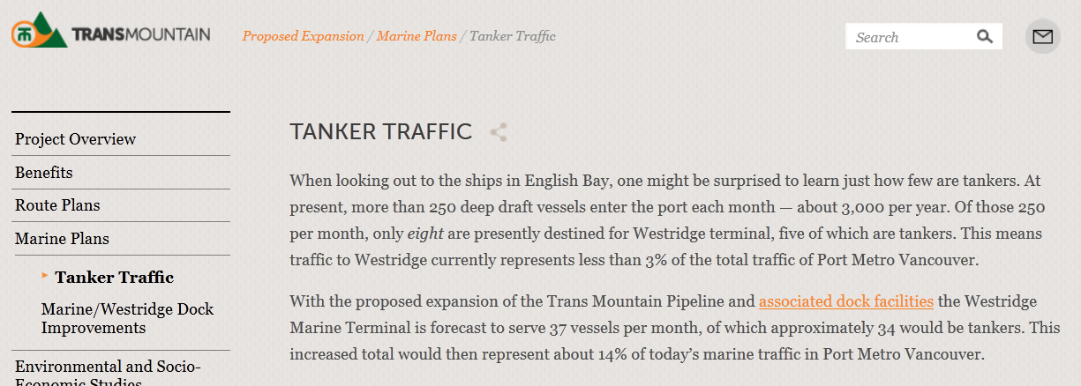
2010 VTRA STUDY – KINDERMORGAN TRAFFIC INCREASES
Source: http://www.transmountain.com/tanker-traffic

Slide 14
Future Scenario 3 DELTA/WESTSHORE/NEPTUNE
Presentation by: J. Rene van Dorp
GWU Personnel: Dr. J. Rene van Dorp
VCU Personnel: Dr. Jason R. W. Merrick
APRIL 2, 2013
Notes:
14

Slide 15
2010 VTRA STUDY – DELTA/WESTSHORE/NEPTUNE TRAFFIC INCREASES
Focus Vessel | Call Increases | SOURCE/ ANALYSIS
1 | Oil Tanker : None
2 | ATB : 60
3 | Oil Barge : ???? | Bunkering increases at current rate (?)
4 | Bulk Carrier : 104 | Environmental Assessment Report
5 | Container Vessels: 15 (DTRRIP) + 260 (DP2) | Environmental Assessment Report
+ 15
+ 260
+ 104
+ 60

Slide 16
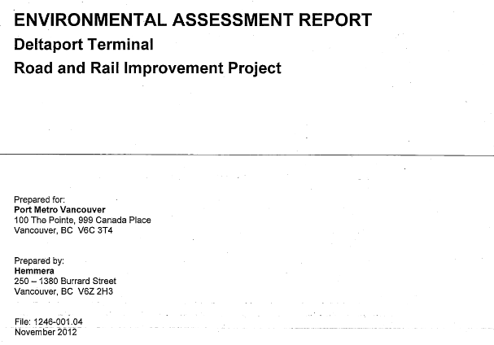
2010 VTRA STUDY – DELTA/WESTSHORE/NEPTUNE TRAFFIC INCREASES
http://www.portmetrovancouver.com/Libraries/PROJECTS_CCIP/DTRRIP_Environmental_Assessment_Report_-_Final.sflb.ashx

Slide 17
Future Scenario 4 OTHER TRENDS
Presentation by: J. Rene van Dorp
GWU Personnel: Dr. J. Rene van Dorp
VCU Personnel: Dr. Jason R. W. Merrick
APRIL 2, 2013
Notes:
17

Slide 18
2010 VTRA STUDY – TREND CHANGES??
FOCUS VESSEL | VESSEL TYPE | CHANGE UP OR DOWN | SOURCE/ ANALYSIS
1 | Oil Tanker | ??
2 | ATB | ??
3 | Oil Barge | ??
4 | Bulk Carrier | ??
5 | Container Vessels | ??
SUGGESTED APPROACH TOWARDS TREND DEFINITION:
Keep interacting vessels (IV’s) at VTOSS 2010 levels
Trends ought to be changes not as a result of three future projects being considered. Implies historical trend analysis for VTRA study area (not straightforward!)

Slide 19
2010 VTRA STUDY – TREND CHANGES??
SUGGESTED APPROACH TOWARDS TREND DEFINITION:
Keep interacting vessels (IV’s) at VTOSS 2010 levels
Trends ought to be changes not as a result of three future projects being considered.
Historical trend analysis for VTRA study area ???
(not straightforward!)
DECREASES DUE TO RAIL/PIPELINE SHIFTS

Slide 20
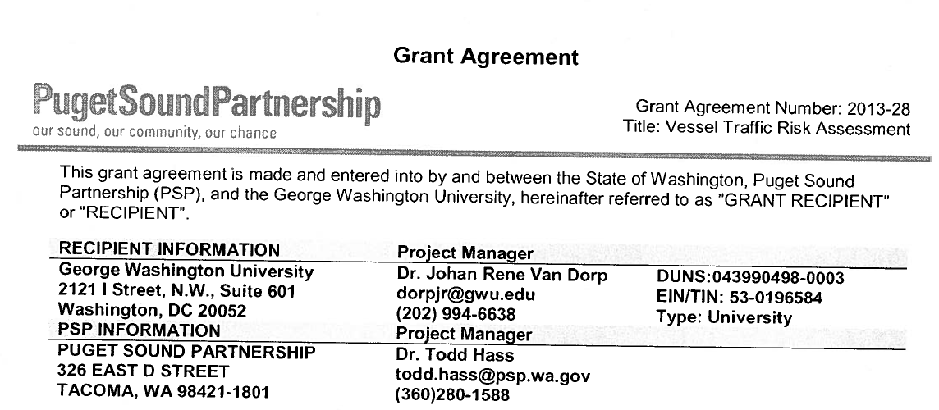
2010 VTRA STUDY – TREND CHANGES??
SOURCE:

Slide 21
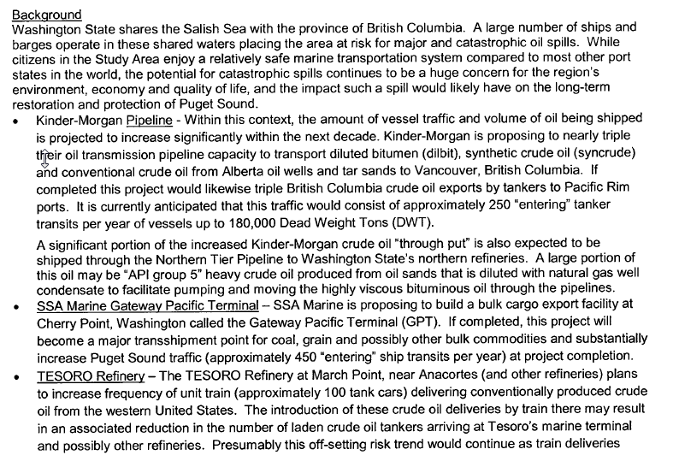
2010 VTRA STUDY – OTHER SUGGESTIONS TREND CHANGES??
Kinder Morgan Future Project: Being considered
Gateway Future Project Being considered
Decided not to include because too speculative ?

Slide 22
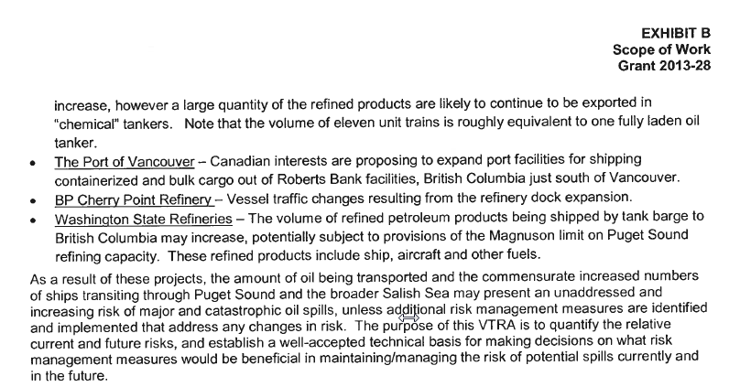
2010 VTRA STUDY – OTHER SUGGESTIONS TREND CHANGES??
Delta/Westshore/Neptune Future Project: Being considered
Include BP future forecasts from former VTRA in future trend?
Some are included in Delta Future Project. Others?

Slide 23
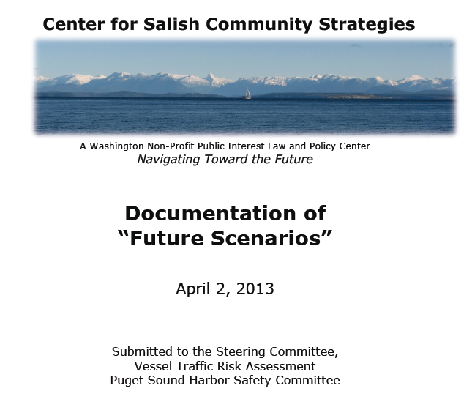
2010 VTRA STUDY – OTHER SUGGESTIONS TREND CHANGES??

Slide 24
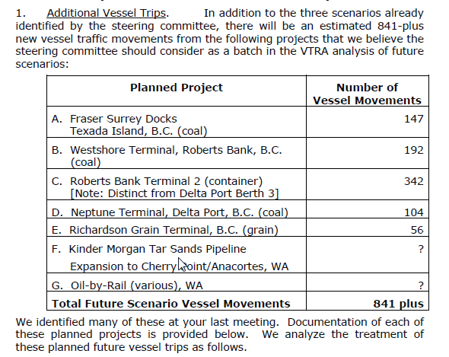
2010 VTRA STUDY – OTHER SUGGESTIONS TREND CHANGES??
We already
covered some
of these, no?
Which are not
yet covered?
Should they
be included ?

