Slide 1
The Pragmatic Theory solution to the Netflix Grand Prize
Rizwan Habib
CSCI 297
April 15th, 2010

Slide 2
Pragmatic Theory
“The theory behind team Pragmatic Theory is that we don't have a theory.”
“We will literally try anything and everything... and this approach has not let us down so far.”
Team consists of
Martin Piotte, 43, electrical engineer, and
Martin Chabbert, 32, software engineer,
both located in Montreal, working in field of telecommunications as computer engineers
No formal academic background in either machine learning or mathematics.
Joined the competition in March 2008
Managed to hit the “number one rank” on March 13th 2009
Team with the longest period of “number one rank”

Slide 3
BellKor’s Pragmatic Chaos
Reached 10% improvement as part of team BellKor’s Pragmatic Chaos on June 26th, 2009
Officially declared as Netflix Grand Prize winners on September 21st 2009
Individual % improvements
Pragmatic Theory: 9.77
BellKor in BigChaos: 9.70
BigChaos: 9.47
BellKor: 9.46
Team Contributions
Each team contributed their basic models and meta models (model achieved through blend of basic models)
Final Blending from BigChaos

Slide 4
Dataset
Quadruplets
<user, movie, date of grade, grade>
<int ID, int ID, Timestamp (day), {1,2,3,4,5}>
Separate dataset provides movie Title and Release year
Dataset is perturbed to protect the privacy of viewers
Triplets
<user, movie, date of grade>
Dataset is divided into two “statistically equivalent” subsets
Training dataset (quadruplets)
Qualifying dataset (triplets)

Slide 5
Training Dataset (quadruplets)
Training Dataset
100,480,507 ratings of
17,770 movies by
480,189 users
An average user rated over 200 movies
An average movie was rated by over 5000 users
Large variance
some movies in the training set have as little as 3 ratings
one user rated over 17,000 movies
Probe dataset
1,408,395 ratings within the training dataset
a subset which is representative of the whole set
Probe set = Training set – a fix known set

Slide 6
Qualifying Dataset (Triplets)
2,817,131 ratings divided into two halves
Quiz set with 1,408,342 ratings
Test set with 1,408,789 ratings
A participating team's algorithm must predict grades on the entire qualifying set
but they are only informed of the score for Quiz set
performance on Test set is used by the jury to determine potential prize winners

Slide 7
The Challenge
For each movie in the training set, predict its average grade in qualifying set
Trivial algorithm has an RMSE of 1.0540 on training set
CineMatch can predict
Quiz set with an RMSE of 0.9514 on training set
Test set with an RMSE of 0.9525 on quiz set
CineMatch achieves a 10% improvement over the trivial algorithm
Winner had to improve CineMatch by 10%; by predicting
Quiz set with an RMSE of 0.8563 on training set
Test set with an RMSE of 0.8572 on quiz data
Winner is a 20% improvement over Trivial algorithm

Slide 8
Improvement by 10%?
Netflix claims that a “1% improvement of the RMSE can make a big positive difference in the identity of the "top-10" most recommended movies for a user.” Reference
What is the probability that a user will grade a movie as 5 out of “top-10” recommendation predicted for him
There is no lower bound or any known relationship between RMSE and this probability
Reference ?

Slide 9
Process of Prediction
(Linear Least Square Regression)
Given four data points (x, y)
(1,6), (2,5), (3,7), and (4,9)
Find a line
y = a +bx that
best fits these four points. I.e.
find a and b such that the system of equations
a + b*1 – 6 = 0 (A)
a + b*2 – 5 = 0 (B)
a + b*3 – 7 = 0 (C)
a + b*4 – 9 = 0 (D)
is solved in some “best sense” for a = a’ and b = b’
Now, the point (5, z) can be predicted with y’ = a’ + b’x
But how accurate the value of z is
This is where RMSE comes in

Slide 10
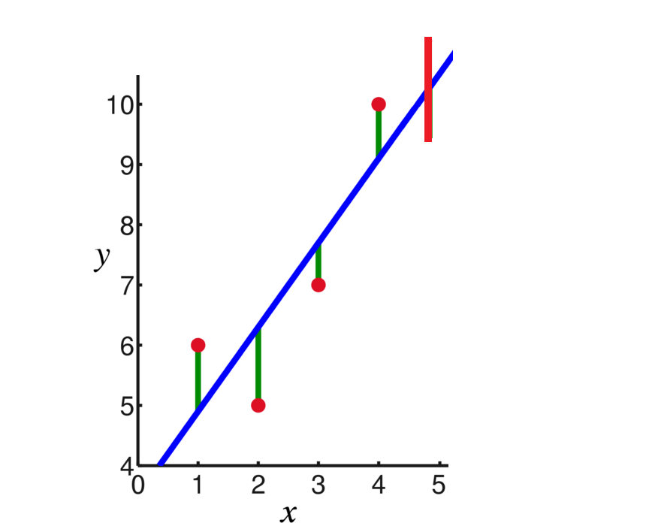
RMSE
Define S(x, y) = A^2+B^2+C^2+D^2; calculate
S(x, u) => a = 3.5; (y = u is minimum, i.e. solve d/dx (S) = 0 )
S(v, y) => b = 1.4; (x = v is minimum, i.e. solve d/dy (S) = 0 )
“best fit” line is now
y = 3.5 + 1.4x (1)
Calculate the residuals’ error of (1) with given points
1.1, − 1.3, − 0.7, and 0.9
And RMSE is
S(3.5, 1.4) = 4.5
(z-4.5) <= z’ <= (z+4.5)
z lies somewhere on red line

Slide 11
Model and Meta-Parameters
M1: the line y = 3.5 + 1.4x is a prediction model
a = 3.5 and b = 1.4 are meta-parameters or predictors of this model
The model has a precision of 4.5
M2: a second model can be generated by “best fitting”, say, y = ax^2+bx+c
a = a’, b = b’ and c=c’ with a precision of RMSE
M2 would be better then M1 if RMSE < 4.5

Slide 12
Blending or “Meta-Equations”
Now, what about be the RMSE of
Y = foo*M1 + bar *M2, where (foo + bar) = 1
A linear combination of predictors
Blending is the process of “approximating the approximators”
It is “best fitting” of approximation curves to represent original data
Its works on predictors, not on original data
Recursive prediction
Level 0: given, the original data set
Level 1: a predictor, best fit of data set (RMSE-1)
Level 2: a blend, best fit of two or more predictors (RMSE-2 <= RMSE-1)
Level N: a blend, best fit of two or more predictors or blends or a combination
(RMSE-N <= RMSE)
Winner
A blend of two or more predictor is in itself a valid predictor
More on blending later

Slide 13
Pragmatic Theory contribution to BPC
Nearly 500 predictors
44 different models with 577 unique variants
BK4 with 128 variants
Matrix Factorizations 1 with 57 variants
5 different models each contributing 2 variants only
5 different models each contributing 1 variant only
906 Blends
457 blends with Neural Nets
444 blends without Neural Nets
5 Quiz Set Variable Multiplication blends

Slide 14
Predictors: the Good, the Bad, and the Ugly
Presume that P is a predictor with an RMSE of X on Probe Set only
Calculate RMSE of P on training set, say its Y
Training set = Probe set + a fixed subset
If X == Y then
P is a good predictor
Else P is bad predictor
Submit good P to Netflix, they will calculate an RMSE for Qualifying set, but will notify only RMSE Z on Quiz set
If Z == X then
X is a reasonably good predictor
Else …
The probability that X would do good on Test Set is now reasonable.
Test Set = Qualifying Set – Quiz Set
Netflix has a winner RMSE limit on Quiz set as well

Slide 15
The Simplex
Nelder-Mead Simplex method
A hueristic, ideal for nonlinear optimization-in PT case, for minimization of RMSE
PT uses it for “simultaneous minimization” of two or more parameters, instead of using “freeze and minimize”
Method starts with a simple shape of (m+1) points, m being number of parameters
For two parameter, the shape is a triangle
At each successive step, another point is calculated, and the triangle shape is redrawn to minimize some criterion
Generally used to yield a starting point for other methods to work on
Working animation (wiki)

Slide 16
Prediction Baselines
It is a “simple approximation of the rating as an element of the model”
Allows to evolve level 0 into level 1
PT developed two such baseslines
Baseline1(u, m)
Baseline2(u, m)
Baseline(u, m) = µ + a*f(u) + b*g(m)
µ is global mean grade
f(u) is regularization function for user u
g(m) is regularization function for movie m
a and b are “some” regularization parameters
Baseline training
Baseline is trained using “least square regression” for u and m
a and b are optimized using Nelder-Mead Simplex Method

Slide 17
Baseline2(u, m)
= µ + (1+s_{baseline2(u)})*b_{baseline2,m}(m)+b_{baseline2,u}(u)
= µ + (1+x₁)*x₂+x₃
b_{baseline2,m}(m) is movie bias
b_{baseline2,u}(u) is user bias
(1+s_{baseline2(u)}) is movie bias scale
Half of user u rating of all movies is 5
user u is bias towards rating movie as 5
Or, probability of user u rating a movie m as 5 is 0.5
User bias tires to simulate this behavior
Half of movie m rating by all users is 5…
(1+s_{baseline2(u)}) is close to 1 for users with very few rating
grade(u, m) = missing then grade(u, m) = 1-ish
No such normalization for movie m
Probable assumption that movie m has reasonable amount of rating
Generally true, as only 18K movies with over 100M ratings

Slide 18
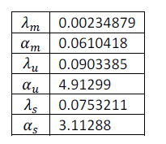
Training Baseline2
(1+s_{baseline2(u)}), b_{baseline2,m}(m) and b_{baseline2,u}(u) are chosen by minimizing (using LSR)
(r-B(u, m))² + c₁*f(m)B(m) ² +c₂ g(u)B(u) ² + c₃ h(u)s(u) ²
Regularization parameters are optimized by
minimizing error on Probe set using Simplex

Slide 19
The BK Models
BK for BellKor
184 variants of 5 flavors of BK
Models are linear but with a non-linear envelope
Linear model * nonlinear factor
It can even model behavior of two users who are sharing an account (family Netflix account)
Latent features: rating has a “time components”
Frequency of “5” rating
Number of rating by user u in a day
Number of rating of movie m in a day
Avg. date of rating, relative to prediction
Rating based movie “grouping”
Movie Neighborhood prediction
Movie Appreciating vs. Movie rating
User u “5” might not be the same as user v “5”
Frequency based models are most used
128 models out of total 184 BK models
Around 500 total

Slide 20
BK3 Model
“Frequency based time dependant rating with time independent bias”
Date deviation
t_{u} is mean date of all rating
t is date of the rating
k₁ and k₂ are regularization parameters
dev_{u} is an offset to force mean dev(u, t) equal to zero
Time dependant rating
m rated by u at time t
z is the function which depends on Eq. 18
Rho₂ is a non-linear envelope
(z on next slide)

Slide 21
z(u, m, t)
z = biases + “sum over all normalized latent features” + offset
z(u, m, t) = rating mean + biases (user, date, ) + sum of all movies frequency and date related latent features (time components) + time independent user features + per day correction to user latent features + sum of feedback of movie m rated by user u normalized (used to guess missing ratings) + sum of rating of u to j normalized over k rated neighbors + sum of offsets, normalized over k neighbors (rated or not rated) to make the combined mean constant

Slide 22
Blending
Find the least costly mix of 2 ores that will produce an alloy with specified characteristics
If “specified characteristics” of an ore is probabilistic, then blending is non-linear; else it is linear
Find a mix of 2 predictors that will produce a predictor of RMSE < a
If we have 3 predictors x, y and z then blending is finding k₁, k₂ and k₃ such that
k₁*x + k₂*y + k₃*z has an RMSE < a and
k₁ + k₂ + k₃ = 1 (A)
Linear Least Square Regression of predictors
“predicting the predictors”
BPC uses linear as well as non-linear blending
BellKor blending doesn’t even follow equation (A)
BPC blending was done by BigChoas
PT treatment of blending is rudimentary

Slide 23
To Blend or Not to Blend ( Final Netflix Leaderboard)
Rank | Team Name | % improvement | Blend of Rank
1 | BellKor's Pragmatic Chaos | 10.06 | 6, 10, 12
2 | The Ensemble | 10.06 | 3, 4, 5
3 | Grand Prize Team | 9.90 | 8, 9
4 | Opera Solutions and Vandelay United | 9.84 | 5, 11
5 | Vandelay Industries ! | 9.81 | Not in top 12
6 | PragmaticTheory | 9.77 | standalone
7 | BellKor in BigChaos | 9.70 | 10, 12
8 | Dace_ | 9.59
9 | Feeds2 | 9.48
10 | BigChaos | 9.47
11 | Opera Solutions | 9.47
12 | BellKor | 9.46

Slide 24
“What” to Blend
BPC generated nearly 500 predictors
It is impossible to calculate all possible blends
Use a “blend set selection algorithm”
Computer a linear regression all prediction sets over the probe set
For each set, computer a linear regression of the collection without the current set
Remove the set with the smallest contribution and repeat from step 1
Greedy ranking of predictors from worse to best in terms of contribution to linear regression
Exclude a set from the blend if it contribution is less then 3E-6

Slide 25
Non Neural Net Blending and Classifiers
Half of total blends (444 out of 906) used by BPC are non neural net blends.
Classifiers were used to provide a starting point for neural net blends
A classifier is one single property of (1/N)th of Probe set
Get a classifier from (1/N)th of Probe set
Confirm it over the rest of Probe set
Calculate the RMSE1
For the next level of classifier, use RMSE1 as a base RMSE, instead of using the actual RMSE
Results in “stacks” of qualifiers

Slide 26
Per Movie Linear Classifier: An Example
One classifier for each movie
Computer the regularized mean of each movie over Probe set
G is global mean and α is regulation parameter
P(m) is movie m rating in probe set
r(i) is rating for item I
Solved through regression
Each sample is predicted output of pervious state and µ_{m}
Optimization is done to minimize the RMSE of actual probe set versus this calculated µ_{m}

Slide 27
Variable Multiplication Blend
Final step of BPC is a linear regression blend done directly on Quiz set
In its simplest, multiple predictors are developed solely on quiz set and then they are multiplied together
Linear predictor * non-linear predictor = non-linear predictor
Forward Selection
Construct a baseline on 233 sets of pragmatictheory blend using linear regression
Add, multiple of each possible pair of predictor, and then blend again
Select the pair which improves the blend most
Add selected pair to baseline, and run the algo again
Repeat this N times
15 such predictors were chosen and included in the final blend

Slide 28
Blending doesn’t always work
Vandelay Industries! Probe File Exchange
Ensemble and BPC working together^{here}
The Ensemble: 0.856714 (10.06%)
Bellkor's Pragmatic Chaos: 0.856704 (10.06%)
50/50 blend: 0.855476 (10.19%)

Slide 29
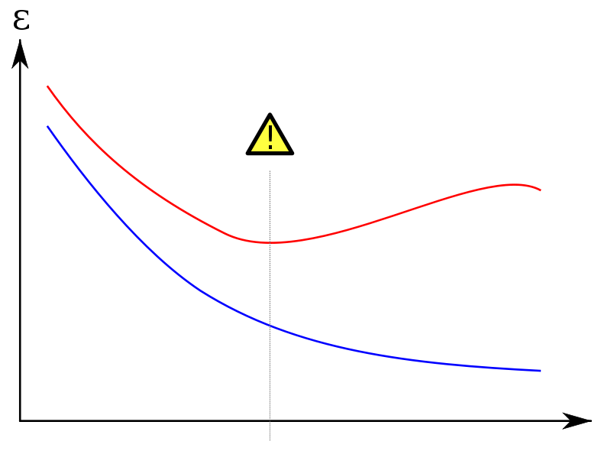
Overfitting
A model “overfit”s if it describes random error or noise instead of the underlying relationship
Overfit model generally have poor predictive performance, as it can exaggerate minor fluctuations in the data
Training error t
Validation error v
v decreases as t decreases but up till certain point
the stop point

Slide 30
Hindsight vs. Foresight
Emp. Err = 50%
Real Err < 60%
Stuct. Risk = 10%
Emp. Err = 10%
Real Err < 30%
Stuct. Risk = 20%
Emp. Err = 1%
Real Err < 100%
Struct. Risk = 99%
Real Error < Empirical Error + Structural Risk
The Nature of Statistical Learning Theory, 1995 by
Vladimir vapnik (AT&T Bell Labs)

Slide 31
Avoiding Overfitting
Additional techniques are used to avoid overfitting, e.g.
cross-validation
regularization
early stopping
BPC uses all three
Calculate a predictor on Probe set and validate it on training set
Almost every term in every equation is regularized
Certain equations are evaluated a fixed number of times, e.g. variable multiplication blend

Slide 32
Questions, Comments….

Slide 33
References
Pragmatic Theory official page at this link
Wiki page on Netflix prize at this link
Wiki page on Linear Least Square at this link
Wiki page on Simplex at this link
Netflix Community entry on Blending, this link
Overfitting: when accuracy measures goes wrong at this link

